Slide 1

AI COMP 469 · Introduction to Artificial Intelligence
CHAPTER 2
Sense
INTELLIGENT
AGENTS
Decide
This chapter builds the framework the rest of the course runs on: what an agent is, what makes its behavior rational, and how the task environment decides which agent design fits.
Act
IN THIS CHAPTER
Define agents: percepts, agent functions, agent programs
Core question: how should an agent choose actions in an environment?
Judge rationality against a stated performance measure
Russell & Norvig, AIMA 4e
Specify tasks with PEAS; classify task environments
Compare reflex, model-based, goal-based, utility-based agents
Add learning; choose atomic, factored, or structured state
AI COMP 469
CSU CHANNEL ISLANDS
Notes:
SLIDE 1 · Chapter 2 cover
Suggested time: 1 minutes · Running total: 1 min · Chapter alignment: Chapter opening
INSTRUCTOR CUE
Replaced cover. The original graphic on this slide read "CHAPTER 2 - PROBLEM SOLVING & SEARCH" and listed state-space representation, BFS, DFS, uniform cost, iterative deepening, greedy best-first, A*, and search complexity. Those are the Chapter 3 objectives. This cover carries the Chapter 2 objectives instead, in the deck's own colors and type.
Worth keeping the old one for Chapter 3 - it is a usable cover for that deck, just not for this one.
TRANSITION
Slide 2 opens the chapter properly with the sense-decide-act loop.
SOURCES
AIMA 4e, Chapter 2 (Intelligent Agents).
Objectives drawn from the deck roadmap on slide 5.

Slide 2
COMP 469
Chapter 2: Intelligent Agents
CSU Channel Islands · Department of Computer Science
Sense
Decide
Act
Core question: how should an agent choose actions in an environment?
Notes:
SLIDE 2 · Chapter 2: Intelligent Agents
Suggested time: 2 minutes · Running total: 3 min · Chapter alignment: Chapter introduction and Section 2.1
Welcome back to COMP 469. Chapter 1 gave us several ways to define artificial intelligence and ended by emphasizing the rational-agent approach. Chapter 2 now turns that broad idea into an engineering framework. Instead of asking only whether a machine appears intelligent, we ask what the machine perceives, what actions it can take, what environment it operates in, and what counts as successful behavior.
The three words on this slide—sense, decide, and act—summarize the central loop. The agent receives information from the environment, chooses an action, changes the environment through that action, and then receives a new percept. Intelligent behavior is therefore not a single calculation. It is an ongoing interaction between an agent and the world around it.
Throughout the lecture, we will use Pac-Man, the two-square vacuum world, and an automated taxi as examples. These examples vary in complexity, but they all let us ask the same design question: given what the agent has perceived so far, what should it do next? By the end of the lecture, you should be able to define an agent formally, specify a task using PEAS, classify an environment, and distinguish the major agent program designs in the chapter.
TRANSITION
We will begin with a quick capability question that reveals why the environment matters so much.
SOURCES
AIMA 4e, Chapter 2 introduction and Section 2.1.

Slide 3
What Can AI Do?
Warm-up
Reliable in formal worlds
Harder in open worlds
A better question to ask
Win at chess or Go
Translate speech
Classify images
Answer structured questions
Drive safely in all conditions
Unload any dishwasher in any home
Buy groceries in a physical store
Act with incomplete information
Do not ask only whether AI “can” do something. Ask what the environment is, what the agent can perceive, what actions are available, and how success is measured.
Task difficulty depends on environment structure.
Pick one task from each column and name the property that makes it easy or hard.
COMP 469 · Chapter 2
2
Notes:
SLIDE 3 · What Can AI Do?
Suggested time: 4 minutes · Running total: 7 min · Chapter alignment: Motivating task environments
Before we define an agent formally, consider the tasks on this slide. Some AI systems perform extremely well in formal environments such as chess or Go. Those games are difficult, but their rules are explicit, the legal actions are limited, and the state can be represented precisely. Other tasks that look ordinary to people—such as unloading any dishwasher in any home—are difficult because the physical environment varies, objects may be hidden, sensors are noisy, and the system must manipulate unfamiliar items safely.
The important question is not simply, 'Can AI do this?' A better set of questions is: What information does the system receive? What actions are available? Does the environment change while the system is deciding? Are other agents present? What errors are acceptable? How will success be measured? A task can become easier or harder depending on how we answer those questions.
For example, buying groceries on a website is primarily a software interaction with structured pages, product records, and digital payment systems. Buying groceries in a physical store requires vision, navigation, object manipulation, social interaction, and adaptation to unexpected conditions. The high-level goal sounds similar, but the task environments are very different.
Use this slide as a warm-up poll. The purpose is not to settle every capability claim. The purpose is to notice that intelligence must be evaluated relative to a specified task environment. That observation leads directly to the agent framework used throughout Chapter 2.
TRANSITION
To evaluate these systems consistently, the course adopts the rational-agent perspective.
SOURCES
AIMA 4e, Chapter 2 introduction; lecture deck warm-up framing.

Slide 4
A Rational-Agent Perspective
Framing
Should we make machines that...
Think like people
Think rationally
human thought process
formal reasoning
Act like people
Act rationally
human-like behavior
choose effective actions
COMP 469 · Chapter 2
3
Notes:
SLIDE 4 · A Rational-Agent Perspective
Suggested time: 3 minutes · Running total: 10 min · Chapter alignment: Bridge from Chapter 1 to Chapter 2
Chapter 1 organized definitions of AI around two dimensions: human versus rational, and thinking versus acting. This course focuses on acting rationally. That does not mean that human thought, human behavior, or formal reasoning are unimportant. It means that our primary engineering standard is whether the system selects actions that are expected to achieve its objective.
A system that acts like a person may reproduce human strengths, but it may also reproduce human mistakes, bias, inconsistency, or fatigue. A system that reasons correctly may still fail to act in time, may lack necessary information, or may be operating in an uncertain environment where formal deduction alone does not identify the best action. Rational action is broader than either imitation or logic.
The phrase 'act rationally' must always be interpreted relative to a performance measure, available evidence, built-in knowledge, and available actions. Chapter 2 will make each of those elements explicit. The result is a framework that can be applied to a vacuum cleaner, a software assistant, a robot, an automated taxi, or a game-playing program.
TRANSITION
The roadmap shows how we move from this perspective to concrete agent designs.
SOURCES
AIMA 4e, Chapters 1 and 2.

Slide 5
2.0 Roadmap: From Agent Loop to Agent Design
Roadmap
Agent loop
Rationality
PEAS
percepts -> action
expected performance
task specification
Environment
Agent types
Representation
what makes it hard
table-driven -> learning
how the world is encoded
How the chapter builds: intuition -> formal model -> environment classification -> agent architecture -> demo.
COMP 469 · Chapter 2
4
Notes:
SLIDE 5 · 2.0 Roadmap: From Agent Loop to Agent Design
Suggested time: 2 minutes · Running total: 12 min · Chapter alignment: Lecture roadmap
This chapter is a design framework rather than a single algorithm. We begin with the agent loop: percepts come in and actions go out. We then define rationality so that we have a standard for judging behavior. Next, we specify the task with PEAS—performance measure, environment, actuators, and sensors.
After the task is specified, we classify the environment. Is it fully or partially observable? Is it deterministic or uncertain? Is it static or changing? Those properties determine what kind of agent program is appropriate. We then examine the major designs, starting with a table-driven baseline and progressing through simple reflex, model-based reflex, goal-based, utility-based, and learning agents.
The final topic is representation: how the agent stores information about the world. Keep this workflow in mind throughout the lecture: define the interaction, define success, characterize the environment, and then choose the agent design.
TRANSITION
We will now define the perceive-act loop formally.
SOURCES
AIMA 4e, Chapter 2 structure.

Slide 6
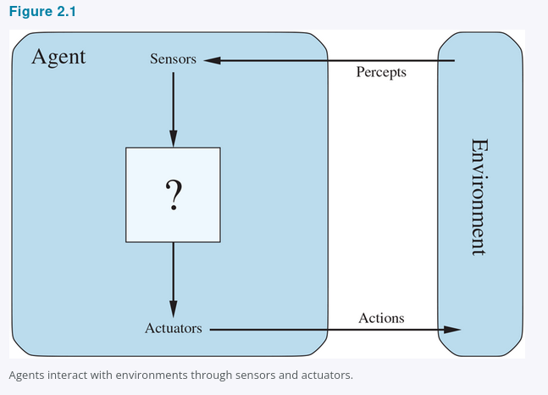
2.1 Agents and Environments: The Perceive-Act Loop
2.1
Examples
Human: eyes/ears -> hands/voice
Robot: camera/lidar -> motors
Software: packets/input -> files/network
Figure 2.1
COMP 469 · Chapter 2
5
Notes:
SLIDE 6 · 2.1 Agents and Environments: The Perceive-Act Loop
Suggested time: 4 minutes · Running total: 16 min · Chapter alignment: Section 2.1
An agent is anything that can be viewed as perceiving its environment through sensors and acting upon that environment through actuators. This definition is deliberately broad. A human agent uses eyes, ears, and other organs as sensors, and uses hands, legs, and the vocal tract as actuators. A robotic agent may use cameras, lidar, infrared range finders, and tactile sensors, with motors and joints as actuators. A software agent may receive files, network packets, keyboard input, or API responses and may act by writing files, sending messages, displaying information, or generating sound.
The environment is the part of the world that matters for the design. It is not automatically the entire universe. For an email-filtering agent, the relevant environment may include incoming messages, user preferences, organizational policies, and attacker behavior. For Pac-Man, it includes the maze, pellets, ghosts, power pellets, and scoring rules.
The arrows in the diagram are important. Percepts travel from the environment to the agent through sensors. Actions travel from the agent back to the environment through actuators. Once an action changes the environment, the next percept may be different. The agent therefore operates in a feedback loop.
This definition is a tool for analysis. We could describe a calculator as an agent, but that description may not add much. The agent framework becomes especially useful when the system has meaningful choices, significant computational resources, and a task environment that requires nontrivial decision making.
TRANSITION
To describe the agent's behavior precisely, we need the terms percept, percept sequence, agent function, and agent program.
SOURCES
AIMA 4e, Section 2.1 and Figure 2.1.

Slide 7
2.1 From Percepts to Agent Functions
2.1
Percept
Percept sequence
Agent function
Agent program
Current sensor content.
Example: current Pac-Man tile, nearby wall, visible ghost.
Complete history of everything the agent has perceived.
Abstract mapping:
percept sequence -> action
Concrete implementation running on an architecture.
percept sequence
action
Do not confuse these two:
Agent function = external mathematical description of behavior
Agent program = internal code that receives current percept and returns an action
Chapter 2 problem: produce rational behavior from a compact program, not a vast lookup table.
COMP 469 · Chapter 2
6
Notes:
SLIDE 7 · 2.1 From Percepts to Agent Functions
Suggested time: 4 minutes · Running total: 20 min · Chapter alignment: Section 2.1
A percept is the content currently received by the agent's sensors. In Pac-Man, a percept might include the current position, nearby walls, visible ghosts, remaining pellets, and legal moves. A percept sequence is the complete history of everything the agent has perceived so far.
The distinction matters because the best action may depend on history. A single camera frame may not reveal whether a car's lights have just turned on, but two consecutive frames can. A current Pac-Man screen may not reveal how long a power-pellet effect has been active unless the agent remembers when the pellet was eaten.
The agent function is an abstract mathematical mapping from percept sequences to actions. It describes what the agent would do for every possible history of percepts. The agent program is the concrete implementation that runs on a physical or computational architecture. A useful teaching phrase is: the function is the behavior we want; the program is the mechanism that computes it.
An agent program normally receives the current percept as input. If the agent function depends on the entire percept sequence, the program must store relevant history in memory. This is why internal state becomes central when we move from simple reflex agents to model-based agents.
Chapter 2's central engineering problem is not merely to define a rational mapping in principle. It is to produce rational behavior from a program that is compact enough to store, efficient enough to run, and capable of operating in the actual environment.
TRANSITION
Now that behavior can be described, we need a standard for deciding whether the behavior is good.
SOURCES
AIMA 4e, Section 2.1.

Slide 8
2.1 The Vacuum World and Its Agent Function
2.1
Figure 2.2 — Two squares, A and B
Figure 2.3 — Partial tabulation
Percept sequence
Action
A
B
[A, Clean]
Right
agent
[A, Dirty]
Suck
[B, Clean]
Left
dirt
[B, Dirty]
Suck
One agent function: if the current square is dirty, then Suck; otherwise move to the other square.
[A, Clean], [A, Clean]
Right
[A, Clean], [A, Dirty]
Suck
Percepts: which square, and whether it is dirty.
Actions: Left, Right, and Suck; NoOp is added in some variants. The agent starts in A.
⋮ ⋮
Fill the right-hand column differently and you have a different agent
Bound the percept sequence at length T and the table still needs |P| + |P|² + … + |P|ᵀ rows. The tabulation is an external description of behavior; the agent program is what we actually have to write.
Figures 2.2 and 2.3
COMP 469 · Chapter 2
7
Notes:
SLIDE 8 · 2.1 The Vacuum World and Its Agent Function
Suggested time: 4 minutes · Running total: 24 min · Chapter alignment: Section 2.1, Figures 2.2 and 2.3
This is the example we will return to for the rest of the chapter, so it is worth setting up carefully. The world has two squares, A and B. Each square is either clean or dirty. The agent perceives which square it currently occupies and whether that square contains dirt. It can move left, move right, suck, or do nothing, and it starts in square A.
The agent function is the mapping from percept sequences to actions, and here we can actually write part of it down. Look at the first four rows. Given the single percept that we are in A and A is clean, this particular agent moves Right. Given that we are in A and A is dirty, it sucks. The pattern continues for square B. The next two rows show what happens with a percept sequence of length two, and the table continues from there.
Two things are worth pausing on. First, the table grows extremely quickly. With four possible percepts and a lifetime of T steps, a complete table needs four plus four squared plus four cubed, and so on, up to four to the T. Without a bound on sequence length the table is infinite. Second, and more importantly for design: this table is an external characterization. It describes what the agent does, not how it does it. The little rule underneath the left figure produces exactly these rows using two comparisons and no memory at all.
That gap between the table and the rule is the whole engineering problem of Chapter 2. The obvious question then becomes: what is the right way to fill in the right-hand column? Filling it in differently gives a different agent, and some of those agents are better than others. Deciding which are better requires a standard, which is what rationality gives us.
TRANSITION
To say which column is the right one, we need a standard for judging behaviour.
SOURCES
AIMA 4e, Section 2.1, Figures 2.2 and 2.3.

Slide 9
2.2 Good Behavior: Rationality Is Expected Performance
2.2
A rational agent selects the action expected to maximize its performance measure.
Performance measure
Prior knowledge
What counts as success?
What does the agent already know?
Available actions
Percept sequence
What can the agent actually do?
What evidence has it observed?
Rationality is not hindsight perfection. It uses evidence available at the time.
COMP 469 · Chapter 2
8
Notes:
SLIDE 9 · 2.2 Good Behavior: Rationality Is Expected Performance
Suggested time: 5 minutes · Running total: 29 min · Chapter alignment: Sections 2.2.1 and 2.2.2
A rational agent is one that does the right thing, but Chapter 2 gives that phrase a technical meaning. The agent's behavior is evaluated by a performance measure. The performance measure scores the consequences produced in the environment, not the internal elegance of the program.
What is rational at a particular moment depends on four things. First is the performance measure that defines success. Second is the agent's prior knowledge of the environment. Third is the set of actions available to the agent. Fourth is the percept sequence observed so far. Change any one of these and the rational action may change.
The formal idea is that, for each possible percept sequence, the agent should choose the action expected to maximize the performance measure, given the evidence in that percept sequence and the built-in knowledge it has. The word expected is essential. The agent chooses under uncertainty and cannot be judged as if it had access to facts it never perceived.
Consider the two-square vacuum agent. The rule 'if dirty, suck; otherwise move to the other square' can be rational if the layout is known, the dirt does not reappear, movement has no cost, the available actions are limited, and the agent correctly perceives location and dirt status. The same rule becomes irrational if movement is penalized, if the environment is larger, if dirt reappears, or if the agent cannot perceive its location.
Rationality is therefore not an isolated property of a piece of code. It is a relationship among the agent, its evidence, its capabilities, its objective, and its environment.
TRANSITION
Because rational agents optimize what we specify, the design of the performance measure is critical.
SOURCES
AIMA 4e, Sections 2.2.1 and 2.2.2.

Slide 10
2.2 Rational? Only Under Stated Assumptions
2.2
What makes this agent rational
Change one line and it is irrational
Performance: one point for each clean square at each time step, over a lifetime of 1000 steps.
The geography is known in advance, but the dirt distribution and the starting square are not.
Clean squares stay clean; Suck cleans the current square; moving into a wall leaves the agent where it is.
The only actions are Right, Left, and Suck, and the agent perceives its location and dirt status correctly.
Penalize each movement: once the floor is clean the agent oscillates forever and bleeds points. Add NoOp and stopping becomes the rational choice.
Let clean squares become dirty again: it must go back and re-check them periodically.
Hide the geography: it now has to explore before it can clean efficiently.
Remove the location sensor: [Clean] no longer tells it whether to go Left or Right.
Rationality is a relation, not a property of the program
The same four lines of code are rational under the left column and irrational under the right. Nothing about the code changed — the performance measure, the prior knowledge, the action set, or the percepts did.
Exercise 2.VACR asks you to design agents for each of these variants.
COMP 469 · Chapter 2
9
Notes:
SLIDE 10 · 2.2 Rational? Only Under Stated Assumptions
Suggested time: 5 minutes · Running total: 34 min · Chapter alignment: Section 2.2.2
We just defined rationality in terms of four things: the performance measure, the agent's prior knowledge, the actions available, and the percept sequence to date. This slide makes that definition do real work.
On the left are the assumptions under which the simple vacuum rule is genuinely rational. Notice how specific they have to be. The performance measure awards a point per clean square per time step over a thousand steps. The geography is known but the dirt and the starting square are not. Clean squares stay clean. There are exactly three actions. Perception is accurate. Under those conditions, no other agent does better in expectation, so this one is rational — not merely acceptable, but optimal.
Now read the right column. Add a one-point penalty for each movement and the agent's behaviour after the floor is clean turns into pure loss; it should do nothing once it is sure everything is clean. Let dirt reappear and a good agent has to re-check squares. Take away the map and the agent must explore first. Take away the location sensor and the percept [Clean] no longer determines whether Left or Right is correct — that is the infinite-loop case we will see under simple reflex agents.
The lesson students should carry out of this slide is that you cannot look at a piece of code and pronounce it rational. Rationality is a relationship among the agent, its evidence, its capabilities, its objective, and its environment. When an exam question asks whether an agent is rational, the correct first move is to ask what is being assumed.
TRANSITION
Because rational agents optimize exactly what we specify, the design of the performance measure deserves its own scrutiny.
SOURCES
AIMA 4e, Section 2.2.2; Exercise 2.VACR.

Slide 11
2.2 Performance Measures: Be Careful What You Ask For
2.2
Bad measure
Better measure
Reward the vacuum for amount of dirt cleaned.
Failure mode: dump dirt, clean it, dump it again.
Reward clean squares over time.
Measure the environment outcome, not the agent’s visible effort.
General lesson
Design performance measures according to what you actually want achieved in the environment.
Connection to Chapter 1: wrong objectives create the King Midas / value-alignment problem.
COMP 469 · Chapter 2
10
Notes:
SLIDE 11 · 2.2 Performance Measures: Be Careful What You Ask For
Suggested time: 4 minutes · Running total: 38 min · Chapter alignment: Section 2.2.1
A performance measure should reward the state of the environment that we actually want, not a convenient proxy for effort. The vacuum example makes this clear. If we reward the amount of dirt cleaned, a perfectly rational optimizer could clean the dirt, dump it back onto the floor, and clean it again. The measured activity increases, but the real objective is not achieved.
A better measure rewards clean squares over time. We might also include penalties for electricity use, noise, damage, or unnecessary movement. The exact measure depends on what the designer and users value. The important principle is to specify the desired outcome rather than prescribing a visible behavior that can be manipulated.
This is the same basic problem discussed in Chapter 1 through the King Midas and value-alignment examples. A capable system can optimize an objective faithfully while producing an outcome that people did not intend. Greater capability does not repair a badly specified objective; it may make the consequences more severe.
Performance measures can also involve genuine tradeoffs. A taxi should be safe, legal, fast, comfortable, fuel-efficient, and profitable. Those goals can conflict. Chapter 2 assumes that a usable measure can often be specified, but it also acknowledges that the measure may be incomplete, uncertain, or different for different users.
TRANSITION
A well-designed objective is necessary, but rationality still does not require perfect knowledge of the future.
SOURCES
AIMA 4e, Section 2.2.1; Chapter 1 value-alignment discussion.

Slide 12
2.2.1 Consequentialism and the Trouble with Averages
2.2.1
Consequentialism
Moral philosophy offers several accounts of the right thing to do. AI has largely adopted one: judge an agent by its consequences. Actions drive the environment through a sequence of states, and the performance measure scores that sequence.
Agent A — steady mediocrity
Agent B — bursts and long breaks
Cleans at a moderate level, continuously, for the whole shift. Never impressive, never absent.
Cleans energetically, then rests for long stretches. Spectacular in bursts, absent in between.
Identical average cleanliness. Which one do you want?
A reckless life of highs and lows, or a safe but humdrum existence? An economy where everyone lives in moderate poverty, or one where some live in plenty and others very poorly? An average hides the question rather than answering it.
And the measure itself may be unknown. One piece of software ships to many users, and we cannot anticipate each one's preferences. That argues for agents that stay uncertain about the true objective and learn it over time (Chapters 16, 18, 22).
COMP 469 · Chapter 2
11
Notes:
SLIDE 12 · 2.2.1 Consequentialism and the Trouble with Averages
Suggested time: 4 minutes · Running total: 42 min · Chapter alignment: Section 2.2.1
Start with the word at the top, because it is the one students most often miss. Consequentialism is the commitment that we evaluate an agent by what happens as a result of its actions, not by whether its reasoning looks elegant, not by whether it resembles human thought, and not by how hard it appears to be working. The agent acts, the environment moves through a sequence of states, and the performance measure scores that sequence.
Now the harder half of the slide. Suppose we fix the obvious bug from the previous slide and reward clean floor rather than dirt collected. We are still not finished. Average cleanliness over time is one number, and two very different agents can produce it. Agent A does a mediocre job constantly. Agent B cleans energetically and then takes long breaks. The average is the same. Which do we prefer?
The textbook calls this a fine point of janitorial science and then immediately notes that it is nothing of the kind. It is the same structure as the question of whether a reckless life of highs and lows beats a safe but dull one, or whether an economy of uniform moderate poverty beats one where some live in plenty and others do not. The point for us as designers is that a summary statistic quietly encodes an answer to a question we never explicitly asked. If variance matters, the performance measure has to say so.
Finally, the box at the bottom. In practice the designer often cannot write down the right measure at all, because copies of the same software go to different users with different preferences. A taxi passenger may want a leisurely ride or a fast one; a virtual assistant starts out knowing nothing about its new owner. That pushes us toward agents that hold the performance measure as something uncertain and learn about it through interaction — which is exactly the thread picked up in Chapters 16, 18, and 22.
SOURCES
AIMA 4e, Section 2.2.1.

Slide 13
2.2 Rationality Is Not Omniscience
2.2
Omniscience
Rationality
Autonomy
Knows the actual outcome of every action. Impossible in realistic environments.
Chooses the action with best expected performance from available evidence.
Learns from percepts rather than depending only on designer assumptions.
Look
Learn
Act
Improve
Information gathering is rational when better percepts improve later decisions.
COMP 469 · Chapter 2
12
Notes:
SLIDE 13 · 2.2 Rationality Is Not Omniscience
Suggested time: 5 minutes · Running total: 47 min · Chapter alignment: Section 2.2.3
Omniscience means knowing the actual outcome of every action before acting. Rationality does not require omniscience, because omniscience is impossible in realistic environments. A rational agent maximizes expected performance using the evidence available at the time; a perfect agent would maximize the outcome that is actually best after all uncertainty has been resolved.
The chapter's street-crossing example illustrates the difference. A person looks, sees no traffic, and begins to cross. An unforeseeable event then causes an accident. The bad outcome does not prove that the original decision was irrational. The decision must be judged from the information available when it was made.
Rationality can also require information-gathering actions. Looking both ways before crossing does not directly move the agent toward the other side, but it improves the percept sequence and therefore supports a better later decision. Exploration in an unknown environment serves the same purpose.
A rational agent should learn from experience. An agent that relies completely on assumptions supplied by its designer lacks autonomy. The chapter's dung beetle and sphex wasp examples show rigid behavior that continues even after environmental assumptions have been violated. An autonomous artificial agent should use percepts and learning to compensate for incomplete or incorrect prior knowledge.
Complete autonomy is not required at the beginning. Designers normally supply initial knowledge, just as biological systems begin with useful reflexes. The goal is that experience gradually makes the agent less dependent on those initial assumptions.
TRANSITION
To design such an agent, we must first specify the task environment completely enough to know what success and available interaction mean.
SOURCES
AIMA 4e, Section 2.2.3.

Slide 14
2.2.3 Three Cautionary Agents
2.2.3
The cargo door
The dung beetle
The sphex wasp
You see a friend across an empty street and start to cross. At 33,000 feet a cargo door falls off a passing airliner and flattens you. Your obituary will not read “Idiot attempts to cross street.”
It fetches a ball of dung to plug its nest. Take the ball away en route and it pantomimes the plugging anyway, never noticing the ball is gone. Evolution built the assumption in.
It drags a caterpillar to the burrow, steps inside to check, then drags it in. Nudge the caterpillar a few inches during the check and it restarts the drag step — dozens of times in a row.
Rationality maximizes expected performance; perfection maximizes actual performance.
No learning, so a violated assumption produces confidently wrong behavior.
It cannot notice that its own innate plan is failing, so it cannot change it.
Autonomy: learn enough to compensate for partial or wrong prior knowledge
Complete autonomy is rarely required from the start — an agent with no experience would have to act at random. Give it initial knowledge and the ability to learn, and after enough experience its behavior becomes effectively independent of what it was told at design time.
COMP 469 · Chapter 2
13
Notes:
SLIDE 14 · 2.2.3 Three Cautionary Agents
Suggested time: 5 minutes · Running total: 52 min · Chapter alignment: Section 2.2.3
These three stories do a lot of work in a small space, and students remember them long after they have forgotten the formal definition, so it is worth telling them properly.
The first is the textbook's own first-person example. I am walking along the Champs Élysées, I see an old friend across the street, there is no traffic and nothing else demanding my attention, so I start to cross. Meanwhile a cargo door falls off an airliner at thirty-three thousand feet and I am flattened before I reach the other side. Was crossing irrational? Obviously not. Rationality maximizes expected performance given the evidence; perfection maximizes actual performance. Demanding the second is not merely unfair to the agent — it makes the design problem impossible, because we would need crystal balls.
The second and third stories cut the opposite way, and this is the part students often miss. Having established that we do not require omniscience, we have to be careful not to have licensed stupidity. The dung beetle plugs its nest with a ball of dung; remove the ball on the way and it goes through the plugging motions with nothing in its grasp. The sphex wasp drags a caterpillar to its burrow, goes in to check that all is well, then drags the caterpillar inside. Move the caterpillar a few inches while the wasp is inside and it goes back to the dragging step — and it will do that dozens of times without ever concluding that something is wrong.
Neither animal is failing to perceive. Each is failing to learn. Their behaviour is rational only in the exact environment their prior knowledge assumes, and it degrades to nonsense the moment that assumption is violated. That is what the chapter means by lacking autonomy. A rational agent should learn what it can, precisely so that it does not depend on the designer having been right about everything.
Connect this back to the previous slide's requirement to look before crossing. Gathering information is itself a rational action, because better percepts improve later decisions. An agent that neither gathers information nor learns from it is not excused by our retreat from omniscience.
TRANSITION
With rationality defined, we can specify the task an agent is meant to solve.
SOURCES
AIMA 4e, Section 2.2.3.

Slide 15
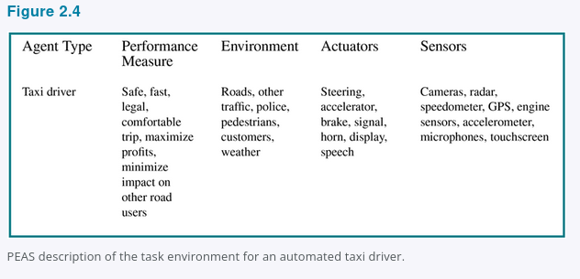
2.3.1 PEAS: Specify the Task Before Designing the Agent
2.3.1
PEAS = Performance measure, Environment, Actuators, Sensors
P
E
A
S
Performance
Environment
Actuators
Sensors
Safe, fast, legal, comfortable trip; minimize time/cost; maximize profit
Roads, traffic, pedestrians, weather, passengers, police, construction
Steering, accelerator, brake, signals, horn, display, speech
Cameras, lidar, radar, GPS, speedometer, engine sensors, voice/touch input
Design rule: specify the task environment as fully as possible first.
Figure 2.4
COMP 469 · Chapter 2
14
Notes:
SLIDE 15 · 2.3.1 PEAS: Specify the Task Before Designing the Agent
Suggested time: 6 minutes · Running total: 58 min · Chapter alignment: Section 2.3.1
PEAS stands for Performance measure, Environment, Actuators, and Sensors. It is the chapter's basic checklist for specifying a task environment. Before choosing an algorithm, model, or programming language, the designer should define these four elements as fully as possible.
For an automated taxi, the performance measure may include reaching the correct destination, safety, compliance with traffic laws, passenger comfort, trip time, fuel use, vehicle wear, cost, and profit. These criteria can conflict, so the designer must decide how tradeoffs will be handled.
The environment includes rural roads, city streets, freeways, traffic, pedestrians, animals, road work, police vehicles, weather, potholes, passengers, and other conditions that affect driving. Restricting the environment makes the problem easier. A system designed only for a mapped, controlled route faces a different task from one expected to drive in any country and in any weather.
The actuators include steering, acceleration, braking, turn signals, displays, speech, and possibly communication with other vehicles. The sensors include cameras, lidar, radar or ultrasound, GPS, speedometer, accelerometer, engine and fuel sensors, and passenger input through voice or a touchscreen.
Notice that PEAS is not an implementation diagram. It does not yet tell us whether to use search, machine learning, rules, or probability. It tells us what problem those techniques must solve. If PEAS is vague, the system requirements and the evaluation criteria will also be vague.
TRANSITION
The next slide shows that the same PEAS structure applies to very different physical and software agents.
SOURCES
AIMA 4e, Section 2.3.1 and Figure 2.4.

Slide 16
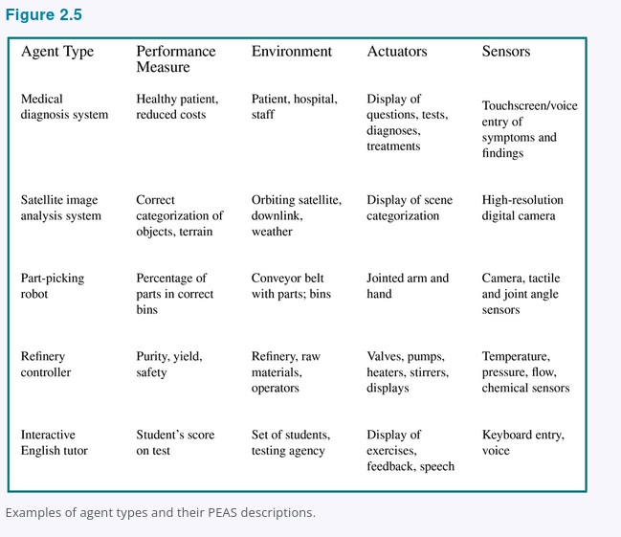
2.3.1 PEAS Examples: Agent Types and Task Environments
2.3.1
PEAS forces the designer to specify success, the world, available actions, and perceptual inputs before choosing an algorithm.
Design checkpoint: if PEAS is vague, the agent design will be vague.
Figure 2.5
COMP 469 · Chapter 2
15
Notes:
SLIDE 16 · 2.3.1 PEAS Examples: Agent Types and Task Environments
Suggested time: 6 minutes · Running total: 64 min · Chapter alignment: Section 2.3.1 and Figure 2.5
This table applies PEAS to five different systems. The purpose is not to memorize every cell. The purpose is to see that an agent is defined by a complete interaction task, not merely by its algorithm.
For a medical diagnosis system, success means a healthy patient at reduced cost. The environment includes the patient, hospital, and staff. The system acts by asking questions, recommending tests, presenting diagnoses, or suggesting treatments. Its sensors are the entered symptoms and findings.
A satellite image analysis system receives high-resolution digital imagery and acts by producing a categorization of objects or terrain. A part-picking robot senses with cameras, tactile sensors, and joint-angle sensors, then acts through a jointed arm and hand. A refinery controller receives temperature, pressure, flow, and chemical measurements and controls valves, pumps, heaters, stirrers, and displays. An interactive English tutor receives keyboard or voice input and acts through exercises, feedback, displays, and speech.
Physical and virtual environments can both be complex. A software agent may interact with millions of users and billions of objects. The fact that an environment is digital does not automatically make it simple, fully observable, or deterministic.
When you design your own agent, use PEAS to expose missing assumptions. If the performance measure says only 'be helpful,' it is not yet measurable. If the sensors do not provide information needed for the requested action, the task may be impossible as specified. If the actuators cannot change the environment in the required way, the architecture is incomplete.
TRANSITION
Once the task is specified, the next step is to classify the environment along dimensions that determine the difficulty of agent design.
SOURCES
AIMA 4e, Section 2.3.1 and Figure 2.5.

Slide 17
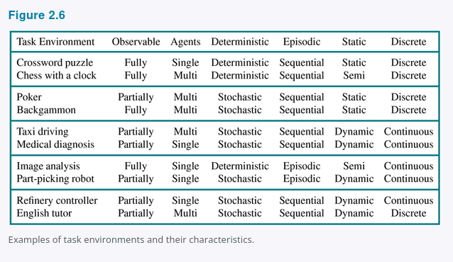
2.3.2 Task Environment Properties
2.3.2
Observable
Agents
Transition
Episodes
Fully <-> Partially
Single <-> Multi
Deterministic <-> Nondeterministic / stochastic
Episodic <-> Sequential
Time
State/action
Knowledge
Static <-> Dynamic / semidynamic
Discrete <-> Continuous
Known <-> Unknown
Hardest case: partially observable, multiagent, nondeterministic, sequential, dynamic, continuous, unknown.
Figure 2.6
COMP 469 · Chapter 2
16
Notes:
SLIDE 17 · 2.3.2 Task Environment Properties
Suggested time: 9 minutes · Running total: 73 min · Chapter alignment: Section 2.3.2
Task environments vary along several dimensions. These dimensions matter because they determine what information the agent needs and which agent designs are likely to work.
First is fully observable versus partially observable. An environment is fully observable when the sensors provide all aspects of state that are relevant to selecting an action. Partial observability can result from missing information, occlusion, or noisy sensors. Observability is relative to the performance measure: the agent does not need every fact in the universe, only the facts relevant to the decision.
Second is single-agent versus multiagent. A crossword puzzle is usually single-agent. Chess is competitive multiagent because the opponent is selecting actions to improve a performance measure that conflicts with ours. Taxi driving is partly cooperative because drivers share an interest in avoiding collisions, and partly competitive because resources such as parking spaces are limited.
Third is deterministic versus nondeterministic. In a deterministic environment, the current state and action determine the next state. In a nondeterministic environment, more than one outcome is possible. The chapter uses stochastic for models that assign explicit probabilities to outcomes. Real driving must be treated as uncertain because other drivers, mechanical failures, and unobserved conditions cannot be predicted exactly.
Fourth is episodic versus sequential. In an episodic task, each decision is independent of previous decisions. Classifying separate images is often episodic. In a sequential task, current actions affect future states and future choices. Chess, driving, and Pac-Man are sequential.
Fifth is static versus dynamic. A static environment does not change while the agent deliberates. A dynamic environment does. A timed chess game is semidynamic: the board may not change during thought, but the performance score changes as the clock runs.
Sixth is discrete versus continuous. Chess uses discrete states and actions. Driving has continuous positions, velocities, time, and steering angles, even though digital sensors sample those quantities.
Seventh is known versus unknown. This is about whether the agent knows the rules or transition behavior. It is different from observability. Solitaire can be known but partially observable: the rules are known, but hidden cards are not visible. A new video game can be fully observable but initially unknown: the screen shows the complete state, but the player does not yet know what each control does.
The hardest general case is partially observable, multiagent, nondeterministic, sequential, dynamic, continuous, and unknown. Real tasks often combine several of these properties, and the classifications are not always absolute. The purpose is to guide design, not to force every task into a perfectly clean category.
TRANSITION
Pac-Man gives us a compact environment in which many of these properties are visible at once.
SOURCES
AIMA 4e, Section 2.3.2 and Figure 2.6.

Slide 18
2.3.2 Reading the Fine Print on Three Dimensions
2.3.2
Nondeterministic vs. stochastic
Competitive vs. cooperative
Effectively fully observable
Both mean the next state is not guaranteed. The chapter reserves stochastic for models that quantify the uncertainty — “a 25% chance of rain.” Nondeterministic means the possibilities are listed without probabilities — “there is a chance of rain.”
Treat B as an agent when B's performance measure depends on A's behavior. In chess B's gain is A's loss, so it is competitive. For taxis, avoiding collisions raises everyone's score — cooperative, yet still competitive over one parking space.
Sensors need not capture the entire state, only everything relevant to the choice of action, and relevance depends on the performance measure. With no sensors at all the environment is unobservable — and goals may still be achievable (Chapter 4).
One more: semidynamic. The world holds still while you think, but your score does not. Chess with a clock. Crossword puzzles are simply static.
Classifying an environment is an argument you have to defend, not a label you look up. Expect to justify the one you pick.
COMP 469 · Chapter 2
17
Notes:
SLIDE 18 · 2.3.2 Reading the Fine Print on Three Dimensions
Suggested time: 5 minutes · Running total: 78 min · Chapter alignment: Section 2.3.2
The previous slide gave you the seven dimensions as a list. This one covers the three places where students most often lose points, because the textbook's definitions are narrower than the everyday words suggest.
First, nondeterministic versus stochastic. Many sources treat these as synonyms. This textbook does not. Both say the next state is not fully determined by the current state and the action. The distinction is whether the model quantifies the uncertainty. A stochastic model says there is a twenty-five percent chance of rain. A nondeterministic model says there is a chance of rain and stops there. So a model is stochastic when it explicitly deals with probabilities. If you write nondeterministic on an exam for a system with a probability distribution attached, you have described it imprecisely.
Second, single-agent versus multiagent, and then competitive versus cooperative. The subtle question is not whether another entity exists but whether we should model it as an agent. The test is whether that entity's behaviour is best described as maximizing a performance measure whose value depends on our agent's behaviour. Waves at the beach do not pass that test; a chess opponent does. Chess is competitive because by the rules of the game the opponent's maximization is our minimization. Taxi driving is partially cooperative, because avoiding collisions raises everyone's score, and partially competitive, because only one car fits in the parking space.
Third, observability is a spectrum rather than a switch. An environment is effectively fully observable when the sensors detect everything relevant to the choice of action — and what counts as relevant depends on the performance measure, so the same sensors can be sufficient for one objective and insufficient for another. At the far end, an agent with no sensors at all faces an unobservable environment. That sounds hopeless, but Chapter 4 shows that goals can sometimes still be achieved with certainty.
The box at the bottom adds semidynamic, which is the one dimension students tend to drop entirely: the environment itself does not change while you deliberate, but your performance score does. Chess with a clock is the standard example.
TRANSITION
One pair of dimensions gets confused so often that it deserves its own slide.
SOURCES
AIMA 4e, Section 2.3.2.

Slide 19
2.3.2 Known Is Not the Same as Observable
2.3.2
Fully observable
Partially observable
Known
Chess
Solitaire
The rules are given and the whole board is in front of you.
You know the rules perfectly, but you cannot see the cards that have not been turned over.
Unknown
A new video game
A rental car abroad
The screen shows the entire game state, and you still have no idea what the buttons do until you press them.
Unfamiliar geography, different traffic laws, other drivers whose intentions you cannot see, and nervous passengers.
Known/unknown describes the designer's grip on the rules, not the sensors
In an unknown environment the agent has to learn how the world works before it can decide well. And as we saw, the performance measure itself can be unknown — which quietly turns the task into a multiagent one, with the user as the other agent.
COMP 469 · Chapter 2
18
Notes:
SLIDE 19 · 2.3.2 Known Is Not the Same as Observable
Suggested time: 4 minutes · Running total: 82 min · Chapter alignment: Section 2.3.2
This is the single most common confusion in the whole environment taxonomy, so we are spending a slide on it. Known versus unknown is not a property of the environment at all. It describes the state of knowledge that the agent or the designer has about the laws of physics of the environment — what the actions do, and with what outcomes or outcome probabilities. Observability describes what the sensors deliver at run time. They are independent, and the grid shows all four combinations.
Top left, chess. The rules are handed to you and the entire board is visible. Known and fully observable.
Top right, solitaire. You know the rules exactly — you could recite them — and you still cannot see the cards that have not been turned over. Known but partially observable.
Bottom left, a new video game. The screen shows you the complete game state, so there is nothing hidden, and yet you have no idea what the buttons do until you try them. Fully observable but unknown. This is the case that convinces students the two axes really are independent.
Bottom right, driving a rented car in a country you do not know, with unfamiliar traffic laws and nervous passengers. Unknown and partially observable — and the chapter uses precisely this to point out that ordinary taxi driving is hard on every dimension except that the rules are mostly known.
The design consequence is on the bottom line. If the environment is unknown, learning is not optional; the agent has to work out how the world responds before it can choose well. And recall from the performance-measure discussion that the objective itself may be unknown, because the person whose preferences matter has not told us. That pulls the user into the task environment as another agent.
TRANSITION
With the task specified and the environment classified, we can finally look inside the agent.
SOURCES
AIMA 4e, Section 2.3.2.

Slide 20
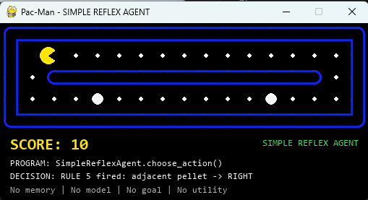
Pac-Man as a Chapter 2 Agent
Example
Sensors / percepts
Walls, pellets, ghost positions, legal moves, power-pellet status.
Actions / actuators
Move left, right, up, or down. Action changes the maze state.
Performance
Maximize score; eat pellets; avoid ghosts; use power pellets safely.
Environment
Sequential, multiagent, discrete, deterministic, known; dynamic in real-time play. Partially observable in richer versions.
In the class demo, the autonomous Pac-Man game implements this loop in code.
COMP 469 · Chapter 2
19
Notes:
SLIDE 20 · Pac-Man as a Chapter 2 Agent
Suggested time: 4 minutes · Running total: 86 min · Chapter alignment: Running example across Sections 2.1-2.4
Pac-Man is useful because the agent, environment, percepts, actions, and performance measure are easy to see. The agent is Pac-Man. The environment includes the maze, walls, pellets, power pellets, ghosts, score, and timing rules.
The percepts depend on what the program is allowed to observe. They may include Pac-Man's position, legal moves, remaining pellets, ghost positions, and power-mode status. The actions are movement commands: left, right, up, down, and sometimes stop.
The performance measure might reward score, pellet completion, survival, speed, or a combination. A high score alone may not be enough if the agent repeatedly takes reckless risks. A survival-only measure may produce an agent that hides and never completes the task. The measure determines what rational behavior means.
The task is sequential because each movement changes future options. It is dynamic because ghosts move while play continues. It is multiagent if ghost behavior is modeled as goal-directed. It is discrete at the grid level. A simplified implementation may be fully observable, while a richer version can include hidden timers or uncertain ghost behavior.
When we run the autonomous Pac-Man code later, we will use this vocabulary to identify the agent program and ask whether it is reflex, model-based, goal-based, utility-based, or a combination.
TRANSITION
Before we move inside the agent, we will stress-test a simple reflex Pac-Man program in two maze levels and use its failures to motivate stronger designs.
SOURCES
AIMA 4e, Sections 2.1-2.4; lecture deck Pac-Man example.

Slide 21
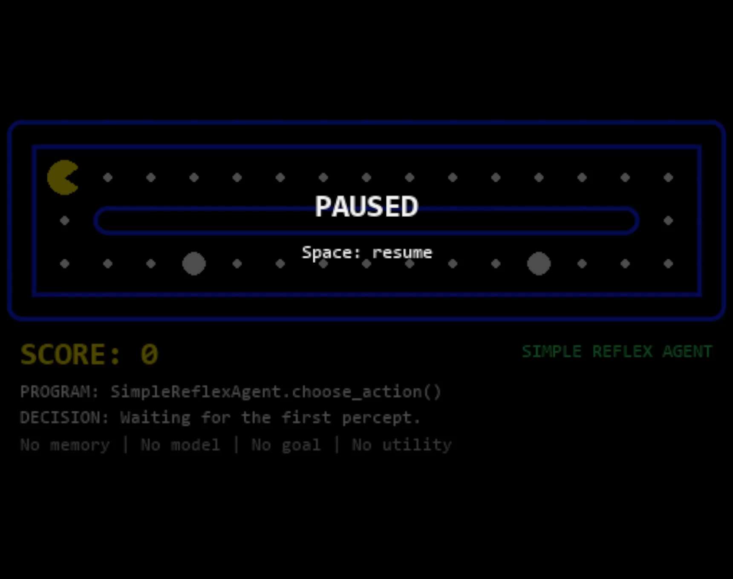
Notes:
SLIDE 21 · Pac-Man Simple Reflex Demo — Level 1
Suggested time: 3 minutes · Running total: 89 min · Chapter alignment: Section 2.4.2; simple reflex agents and motivation
This first Pac-Man clip is a deliberately small stress test for a simple reflex agent. Watch the decision trace below the maze rather than just the score. The program receives the current percept, applies an ordered set of condition-action rules, and returns one movement. It has no memory of where it has been, no model of the maze, no explicit goal state, and no utility calculation.
At first, that limitation is easy to miss. In a straight corridor, a local rule such as 'eat an adjacent pellet' or 'continue in a legal direction' can look intelligent because the geometry happens to make the locally convenient action also useful globally. The agent earns points and appears to make progress.
The important moment comes when useful food is no longer adjacent or when reaching it requires temporarily moving away from the most obvious local direction. The program has no representation of 'remaining food over there' and no route that connects its current square to that food. It can only fire another rule from the current percept.
This is the distinction to keep in mind: successful behavior in a simple environment does not prove that the architecture can solve a more demanding version of the task. A reflex agent can be fast and compact while still being brittle when the current percept does not contain enough information for a good long-term choice.
TRANSITION
Level 2 keeps the same basic agent design but adds detours and branches, making the architectural limitation much harder to hide.
SOURCES
Embedded Pac-Man simple-reflex demonstration in this deck.
AIMA 4e, Section 2.4.2.

Slide 22

Notes:
SLIDE 22 · Pac-Man Simple Reflex Demo — Level 2
Suggested time: 4 minutes · Running total: 93 min · Chapter alignment: Section 2.4.2; limitations of simple reflex behavior
Now the maze has branches and detours. The key experimental control is that the agent program has not become more sophisticated. It still reacts to the current percept with ordered rules, with no remembered route, no internal model of unvisited corridors, and no goal such as 'reach the nearest remaining pellet.' Only the environment has become more demanding.
Watch what happens after the easy adjacent pellets disappear. The agent may continue in a default direction, revisit locations, or choose the first legal action even when that action does not make meaningful progress toward the remaining food. From the program's point of view, two locations that produce the same local percept can trigger the same action even when their broader maze contexts call for different choices.
This is why environment classification matters. A rule set can look adequate when the task effectively reduces to local reactions, then fail when success becomes sequential and requires a multi-step route. The failure is not that the program is too slow. It is that the information used by the decision procedure is too weak for the task.
Also notice what is not happening: the agent is not exploring a search frontier. It is not storing visited states, expanding successor states, selecting a target pellet, or reconstructing a path. Those are planning operations, and they require additional state and problem structure beyond a simple reflex mapping.
answer: Their broader context, history, route structure, or goals can differ. A current-percept-only rule cannot represent those differences.
TRANSITION
The next slide separates the root architectural problem from the search algorithm that could be used inside a stronger agent.
SOURCES
Embedded Pac-Man simple-reflex demonstration in this deck.
AIMA 4e, Sections 2.3.2 and 2.4.2.

Slide 23
What breaks in Levels 1 and 2
The agent sees adjacent percepts only; it does not build a route to remaining food.
Level 1: simple corridor plus hidden lower route
Observed issue
What BFS would add
The rules eat adjacent pellets and then continue or pick the first legal action. Once food is not adjacent, the agent has no search frontier, no map of unvisited corridors, and no target.
BFS could expand reachable grid states from Pac-Man and return the shortest path to a selected pellet, including routes that initially move away from the pellet.
Level 2: detours and branches require planning
Why this is not a BFS failure
Remaining risk
Breadth-first search is never called in this script. The failure is caused by the Simple Reflex design: current percept -> ordered rule -> action.
Even with BFS, the agent still needs a state definition, a goal policy, and replanning when ghosts or pellets change. Otherwise BFS only solves the static shortest-path subproblem.
Root cause: no memory / no model / no goal
BFS adds route search, not intelligence by itself
COMP 469 · Chapter 2
22
Notes:
SLIDE 23 · What breaks in Levels 1 and 2
Suggested time: 5 minutes · Running total: 98 min · Chapter alignment: Sections 2.4.2 and 2.4.4; bridge from reflex behavior
These two demonstrations fail for a specific reason: the agent is making local decisions without constructing a route to the remaining food. Its rules can react to adjacent pellets and legal moves, but once useful food is not adjacent, the agent has no search frontier, no record of unvisited corridors, and no explicit target that defines where a route should end.
The middle-left box is important because it prevents a category error. This is not a breadth-first-search failure. Breadth-first search is never called by the simple reflex program. The program is doing exactly what its architecture says to do: current percept, ordered rule, action. Blaming BFS would be like blaming a database query that the program never executed.
What would BFS add? Given a state representation, a successor function, and a selected goal, BFS can expand reachable grid states level by level and return a shortest path in an unweighted maze. That means it can find a route whose first step temporarily moves away from the visible pellet, something a purely local rule may never choose.
But BFS does not supply the rest of the agent design. Before search is useful, the agent still needs a representation of state, knowledge of walls and legal transitions, a policy for selecting which pellet or condition counts as the goal, and a mechanism for turning the returned path into actions. In a changing game, it also needs to notice when the world has changed and decide when to replan.
So the bottom line has two parts. The root cause of the observed behavior is no memory, no model, and no goal. BFS can add route search, but route search by itself is not a complete theory of intelligent behavior.
TRANSITION
Even after we add BFS as a planner, several limitations remain, especially once the world becomes dynamic or the objective is richer than minimum number of moves.
SOURCES
AIMA 4e, Sections 2.4.2 and 2.4.4; search terminology used here as a
forward reference to the next unit.
Pac-Man demonstrations and analysis on this slide.

Slide 24
BFS helps with reachability, but it is still limited
Use BFS as a planner inside a model-based or goal-based agent, not as a replacement for the agent architecture.
Grid state
(position, walls, food)
Queue frontier
level by level
Visited set
avoids loops
Shortest path
if unweighted
Next action
returned to game
Limitation 1: static model assumption
Limitation 2: unweighted shortest path
Limitation 3: state explosion
Classic BFS assumes the graph is known while searching. Moving ghosts, frightened timers, and disappearing pellets require replanning after each action.
BFS optimizes number of moves, not risk, score, power-pellet timing, or ghost avoidance. Weighted objectives need UCS, A*, or utility-based planning.
A richer state such as position + pellets + ghost positions grows quickly. BFS can become memory-heavy before it becomes strategically useful.
Takeaway: Levels 1 and 2 show that a reflex rule set can look reasonable locally but fail globally. BFS fixes path finding only when paired with a map, a goal, and repeated replanning.
COMP 469 · Chapter 2
23
Notes:
SLIDE 24 · BFS helps with reachability, but it is still limited
Suggested time: 5 minutes · Running total: 103 min · Chapter alignment: Section 2.4.4; forward reference to search and
This slide shows exactly where BFS fits. Start with a grid state containing Pac-Man's position, the walls, and the relevant food configuration. BFS places the start state in a queue, expands states level by level, records a visited set to avoid cycling, and when it reaches a selected goal it can reconstruct a shortest path in an unweighted graph. The agent then executes the next action from that path.
That solves reachability, but it does not solve the entire decision problem. The first limitation is the static-model assumption. Classic BFS searches a graph as though the state-transition structure remains fixed during the search. In Pac-Man, ghosts move, frightened timers expire, and pellets disappear after they are eaten. A practical agent therefore has to observe again and replan when the state changes.
The second limitation is the objective. BFS minimizes the number of edges. It does not automatically minimize danger, maximize score, time a power pellet, trade speed against safety, or reason about probabilities. Once actions have different costs, uniform-cost search becomes more appropriate; with informative heuristics, A* can reduce search; and when several uncertain outcomes must be ranked, utility-based reasoning becomes relevant.
The third limitation is state explosion. A state containing only position is small. Add the set of remaining pellets, ghost positions, frightened timers, and other variables, and the number of distinct states grows rapidly. BFS is memory intensive because it stores a frontier and a visited set, so a richer representation can become expensive before the policy becomes strategically strong.
The takeaway is architectural. BFS is a planning component that can live inside a model-based or goal-based agent. It is not a substitute for the agent architecture. The agent still needs percepts, internal state or a world model, a goal policy, action execution, and repeated interaction with the environment.
TRANSITION
With that motivation in place, we can now formalize what sits inside an agent: the architecture that provides capabilities and the program that maps percepts to actions.
SOURCES
AIMA 4e, Section 2.4.4; BFS details are a forward reference to the
search chapters.
Pac-Man demonstration analysis in this deck.

Slide 25
2.4 Agent Structure: Architecture + Program
2.4
agent = architecture + program
Agent function
Architecture
Agent program
Behavior implemented by the program: percept sequence -> action.
Physical or computational platform: sensors, processors, memory, actuators. The program must fit it — recommend walking and the architecture needs legs.
Software that receives percepts and returns actions.
Why not use a giant lookup table?
Too many percept sequences to store.
Too much work for the designer to fill in.
Too much experience for the agent to learn every entry.
AI problem: produce rational behavior from a compact program, not a vast table.
COMP 469 · Chapter 2
24
Notes:
SLIDE 25 · 2.4 Agent Structure: Architecture + Program
Suggested time: 4 minutes · Running total: 107 min · Chapter alignment: Sections 2.4 and 2.4.1
Chapter 2 summarizes an artificial agent with the equation: agent equals architecture plus program. The architecture is the physical or computational platform. It provides sensors, processors, memory, communication interfaces, and actuators. The agent program receives percepts from that architecture and returns actions for the architecture to execute.
The program must be appropriate for the architecture. A program that selects the action 'walk forward' is useless on a machine with no means of locomotion. A program that expects lidar data cannot operate correctly if the architecture provides only a keyboard.
The agent function remains the abstract mapping from percept sequence to action. The program is one implementation of that mapping. Different programs and architectures can sometimes implement similar behavior, but practical limits such as memory, processing time, sensor quality, and actuator precision affect what can actually be achieved.
One conceptually simple implementation is a lookup table containing the correct action for every percept sequence. The next slides use the table-driven agent to show why a complete mapping may be clear in theory but impossible to implement in realistic environments.
TRANSITION
The table-driven agent is our conceptual baseline for implementing an agent function.
SOURCES
AIMA 4e, Sections 2.4 and 2.4.1.

Slide 26
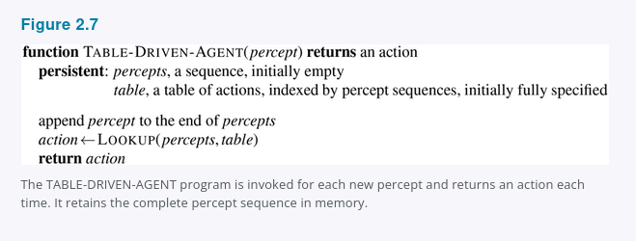
2.4.1 Table-Driven Agent
2.4.1
A table-driven agent stores the entire percept sequence and indexes a table of actions.
What it demonstrates
The agent function can be represented explicitly as a mapping from percept history to action.
Why it matters
It is correct in principle if the table is filled correctly, but it is usually infeasible.
Term to know
Table-driven agent: the simplest conceptual agent program in Section 2.4.1.
Figure 2.7
COMP 469 · Chapter 2
25
Notes:
SLIDE 26 · 2.4.1 Table-Driven Agent
Suggested time: 5 minutes · Running total: 112 min · Chapter alignment: Section 2.4.1 and Figure 2.7
This is the table-driven agent. It is important because it represents the agent function explicitly, even though it is not a practical design for realistic systems.
Read the pseudocode from top to bottom. The function receives the current percept and returns an action. It has two persistent variables. The first is percepts, a sequence that begins empty and retains the complete percept history. The second is table, a fully specified mapping indexed by percept sequences.
Each time the function is called, it appends the new percept to the stored sequence. It then performs a lookup using the entire percept history and returns the action stored in the table. If the table contains the correct action for every possible history, the program implements the desired agent function.
The design has no need to interpret the percept, reason about goals, estimate state, or generalize from similar situations. All of that work has already been performed by whoever created the table. The program simply remembers and looks up.
This makes the table-driven agent useful as a conceptual reference. It demonstrates the difference between an agent function and an agent program. It also makes the scalability problem visible: as the number of possible percepts and the length of the percept history increase, the number of table entries grows explosively.
TRANSITION
The next slide explains why this correct-in-principle design fails as an engineering solution.
SOURCES
AIMA 4e, Section 2.4.1 and Figure 2.7.

Slide 27
Why Table-Driven Agents Fail in Practice
2.4.1
The lookup table grows with every possible percept sequence.
Space problem
Design problem
Learning problem
No physical agent can store every entry for a realistic environment.
No designer can fill in the right action for every possible sequence.
No agent can experience every possible percept sequence.
Key challenge for AI
Write small programs that produce rational behavior without enumerating every possible history.
COMP 469 · Chapter 2
26
Notes:
SLIDE 27 · Why Table-Driven Agents Fail in Practice
Suggested time: 4 minutes · Running total: 116 min · Chapter alignment: Section 2.4.1
The lookup table grows across every possible percept sequence, not merely every current percept. If an agent can receive many different percepts over a long lifetime, the number of possible histories becomes enormous.
This creates three separate failures. First is the space problem: no realistic machine can store every entry. Second is the design problem: no human designer can specify the correct action for every history. Third is the learning problem: no agent can experience enough cases to learn every table entry independently.
The chapter gives extreme examples from automated driving and chess to show that even tightly defined tasks produce tables far larger than any practical storage system. The precise numbers are less important than the growth pattern. A table treats every percept history as a separate case and receives no benefit from structure, similarity, rules, models, goals, or learned generalization.
The table-driven agent still teaches an important lesson. The desired agent function may exist, and a table could represent it in theory, but AI must find compact programs that produce rational behavior without enumerating every possible history. The rest of the agent designs are attempts to exploit structure in the task.
TRANSITION
The simplest compact alternative is a reflex agent that uses condition-action rules.
SOURCES
AIMA 4e, Section 2.4.1.

Slide 28
2.4.1 The Numbers Behind the Failure
2.4.1
70 MB/s
10⁶⁰⁰,⁰⁰⁰,⁰⁰⁰,⁰⁰⁰
10¹⁵⁰
< 10⁸⁰
Visual input from a single taxi camera at 30 fps, 1080 × 720, 24-bit color. Eight cameras is typical.
Entries the lookup table would need for one hour of driving from a single camera.
Entries for chess alone — a tiny, well-behaved fragment of the real world.
Atoms in the observable universe, for comparison.
Newton, not tables
Before the 1970s, engineers and schoolchildren looked up square roots in enormous printed tables. A five-line program for Newton's method on a pocket calculator replaced all of them. The chapter's wager is that AI can do the same for intelligent behavior generally.
No agent can store it, no designer can fill it in, no agent can learn it
TABLE-DRIVEN-AGENT is not wrong — filled in correctly it implements exactly the agent function we want. It is simply unbuildable. The key challenge is producing rational behavior from a small program instead.
COMP 469 · Chapter 2
27
Notes:
SLIDE 28 · 2.4.1 The Numbers Behind the Failure
Suggested time: 4 minutes · Running total: 120 min · Chapter alignment: Section 2.4.1
The previous slide said the table-driven approach is infeasible. This slide is where that claim stops being hand-waving, and the numbers are worth reading out loud because they are genuinely startling.
Start with the input rate. One camera on an automated taxi, at thirty frames per second, 1080 by 720 pixels, twenty-four bits of colour, produces roughly seventy megabytes per second. Eight cameras is a typical configuration. Now count the distinct percept sequences an hour of driving could produce and you get a lookup table with more than ten to the six hundred billion entries.
That number is hard to feel, so anchor it. Chess — a tiny, closed, perfectly-specified fragment of the world — needs a table with at least ten to the one hundred fifty entries. And the number of atoms in the observable universe is less than ten to the eightieth. Chess alone overruns the physical universe by seventy orders of magnitude.
Three consequences follow, and they are independent. No physical agent has the space to store the table. No designer has the time to fill it in. And no agent could ever have enough experience to learn all the right entries. Note that the approach is not incorrect: fill the table in properly and TABLE-DRIVEN-AGENT implements precisely the agent function we wanted. It is correct and unbuildable at the same time, which is a useful thing for students to hold in their heads.
The box in the middle is the optimistic half. Before the 1970s, square roots came out of large printed tables that people carried around. Newton's method, five lines on a calculator, made all of those tables obsolete — not by compressing them, but by capturing the structure that generated them. The question that organizes the rest of this chapter and much of this course is whether we can do for general intelligent behaviour what Newton did for square roots. The chapter's answer is yes, and everything from simple reflex agents onward is an attempt to demonstrate it.
TRANSITION
The first and smallest such program is the simple reflex agent.
SOURCES
AIMA 4e, Section 2.4.1.

Slide 29
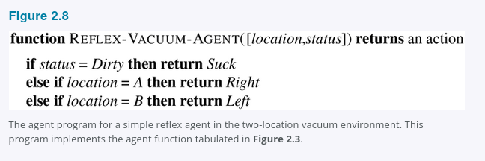
2.4.2 Simple Reflex Agents: Vacuum Pseudocode
2.4.2
Select an action from the current percept only.
Vacuum rule
if status = Dirty then Suck
else if location = A then Right
else if location = B then Left
Why this is reflex
The action depends only on current location and dirt status, not the entire percept history.
Strength: fast and compact. Weakness: brittle when the current percept is incomplete.
Figure 2.8
COMP 469 · Chapter 2
28
Notes:
SLIDE 29 · 2.4.2 Simple Reflex Agents: Vacuum Pseudocode
Suggested time: 5 minutes · Running total: 125 min · Chapter alignment: Section 2.4.2 and Figure 2.8
A simple reflex agent selects an action from the current percept and ignores the rest of the percept history. The vacuum pseudocode shows the idea in its smallest useful form.
The input contains location and status. If status is Dirty, the agent returns Suck. Otherwise, if the location is A, it returns Right. If the location is B, it returns Left. The program does not store previous percepts, remember previous actions, represent a goal, or compare utilities.
This small program can implement rational behavior under a specific set of assumptions: two locations, correct location and dirt sensors, reliable actions, no cost for movement, and dirt that does not reappear. Its compactness comes from using regularities in the environment. The action for a dirty square is the same regardless of history, so the program does not need a separate entry for every percept sequence.
Simple reflex behavior also appears in complex systems. A driving rule might say: if the car in front is braking, initiate braking. The condition-action connection can be implemented with traditional code, a Boolean circuit, or a learned classifier. What makes the agent reflex is not the programming language; it is that action selection depends on the current interpreted percept rather than explicit reasoning about future consequences.
The strength is speed and compactness. The weakness is that the current percept may not contain enough information to identify the true state of the world.
TRANSITION
A general simple reflex architecture separates percept interpretation from rule matching.
SOURCES
AIMA 4e, Section 2.4.2 and Figure 2.8.

Slide 30
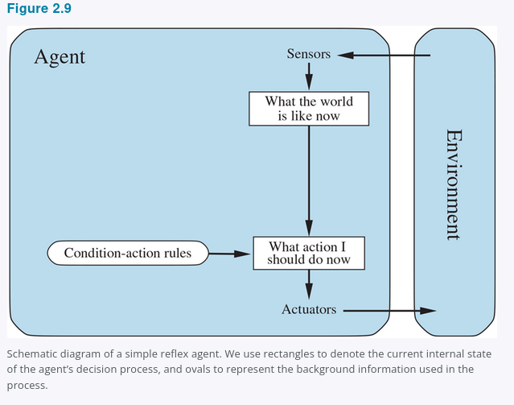
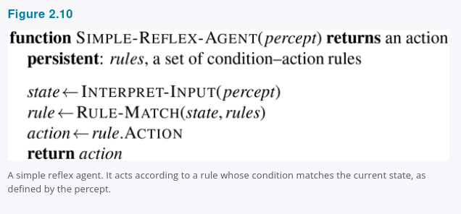
2.4.2 General Simple Reflex Agent
2.4.2
General pattern
Interpret current percept -> match condition-action rule -> return rule action.
Key limitation
If the current percept does not reveal enough state, the rule may choose the wrong action.
Figures 2.9 and 2.10
COMP 469 · Chapter 2
29
Notes:
SLIDE 30 · 2.4.2 General Simple Reflex Agent
Suggested time: 5 minutes · Running total: 130 min · Chapter alignment: Section 2.4.2 and Figures 2.9-2.10
This slide generalizes the vacuum program. The agent receives a percept, interprets it as a description of the current state, matches that state against condition-action rules, and returns the action associated with the first matching rule.
In the pseudocode, rules are persistent. INTERPRET-INPUT converts raw sensor data into a useful state description. For a driving agent, raw pixels might be interpreted as the condition 'car in front is braking.' RULE-MATCH finds a rule whose condition is satisfied. The program then selects rule dot ACTION and returns it.
The diagram separates two questions: what is the world like now, and what action should I do now? A simple reflex agent answers the second question with a condition-action rule. It does not explicitly ask what will happen after the action or whether the action advances a long-term goal.
The chapter notes that 'rules' and 'matching' are conceptual descriptions. An implementation could use if-statements, logic gates, decision trees, or neural components. The architecture is still simple reflex if the chosen action is based only on the current percept-derived state.
This design works best when the environment is fully observable and the correct action can be determined from the current state. When relevant information is hidden or must be inferred from history, the same current percept can require different actions.
TRANSITION
Partial observability exposes the central limitation of simple reflex behavior.
SOURCES
AIMA 4e, Section 2.4.2 and Figures 2.9-2.10.

Slide 31
2.4.2 Condition–Action Rules: Power and Limits
2.4.2
The rule behind the brake pedal
Compression: 4ᵀ → 4
if car-in-front-is-braking then initiate-braking
Ignoring percept history cuts the vacuum agent's relevant percept sequences from 4ᵀ down to just 4.
Why even this rule is fragile
It can be a circuit
It assumes the condition can be read off a single video frame. That works when the car ahead has a centrally mounted brake light.
Older vehicles arrange taillights, brake lights, and turn signals differently, and one image often cannot tell braking from lights simply being on.
A simple reflex agent behind such a car either brakes continuously and needlessly, or never brakes at all.
The rule set is simple enough to implement as Boolean logic gates — or as the nonlinear units of a neural network (Chapter 21).
Learned and innate
Braking on brake lights is learned; blinking when something nears the eye is not. Both are condition–action rules.
Randomizing helps: a coin flip reaches the other square in two steps on average
But that is a trick for escaping loops, not general intelligence. Randomized behavior can be rational in multiagent settings because it defeats predictability; in single-agent environments it usually is not.
COMP 469 · Chapter 2
30
Notes:
SLIDE 31 · 2.4.2 Condition--Action Rules: Power and Limits
Suggested time: 4 minutes · Running total: 134 min · Chapter alignment: Section 2.4.2
We have seen the general simple reflex structure. This slide takes it out of the vacuum world and shows both what the design buys you and where it breaks.
Start with the rule in the dark box. If the car in front is braking, then initiate braking. That is a condition--action rule, and note what has to happen for it to work: some processing on the visual input must establish the condition we are calling car-in-front-is-braking, and then a fixed connection in the agent program fires the action. Humans run enormous numbers of these. Some are learned, like this one; some are innate, like blinking when something approaches your eye.
Now the three cards on the right, which are the case for the design. The compression is dramatic: ignoring percept history takes the vacuum agent from four to the T relevant percept sequences down to four. A further small reduction comes from noticing that when the square is dirty, the action does not depend on where you are. And the resulting program is simple enough to be a Boolean circuit — or, swapping logic gates for nonlinear units, a neural circuit, which is where Chapter 21 picks the thread back up.
Then the failure, in red. The braking rule assumes the condition is determinable from the current percept, meaning one frame of video. That holds if the car ahead has a centrally mounted brake light. It does not hold for older models with different taillight arrangements, where a single image cannot distinguish braking from the lights merely being on. The reflex agent behind such a car either brakes continuously and unnecessarily, or — worse — never brakes at all. A little bit of unobservability causes serious trouble.
Finally the bottom line. The vacuum agent without a location sensor loops forever, and randomization does escape the loop: flip a coin between Left and Right and you reach the other square in two steps on average. But be clear with students about what that is. It is a useful trick, not intelligence. Randomized behaviour of the right kind can be rational in multiagent environments precisely because it avoids being predictable. In single-agent environments it usually is not, and a more sophisticated deterministic agent does better. The real fix is internal state, which is the next design.
TRANSITION
The next slide works through the vacuum version of this failure in detail, and then we build the fix: an agent that keeps internal state.
SOURCES
AIMA 4e, Section 2.4.2.

Slide 32
When Simple Reflex Fails: Partial Observability
2.4.2
Problem
Vacuum example
Temporary fix
The current percept does not contain enough information to choose correctly.
If the agent sees only Clean/Dirty but not location, moving Left or Right can loop forever.
Randomization can sometimes escape loops, but it is not general intelligence.
Better solution: maintain internal state or use a model of the world.
percept
memory
model
action
COMP 469 · Chapter 2
31
Notes:
SLIDE 32 · When Simple Reflex Fails: Partial Observability
Suggested time: 4 minutes · Running total: 138 min · Chapter alignment: Section 2.4.2
Suppose the vacuum agent loses its location sensor and can perceive only Clean or Dirty. The response to Dirty is still clear: Suck. The response to Clean is now ambiguous. If the agent always moves Left, it can fail forever when it starts in A. If it always moves Right, it can fail forever when it starts in B.
The problem is not a missing condition-action rule. The problem is that the current percept does not identify the relevant state. The same percept, Clean, can occur in different situations that require different actions.
Randomization can sometimes escape a loop. The vacuum might randomly choose Left or Right when it sees Clean. In this tiny environment, that may eventually reach the other square. The chapter treats randomization as a useful trick, not a general replacement for knowledge. In many tasks, random action would be inefficient or unsafe.
Pac-Man can have the same issue. If the current screen does not reveal how much frightened time remains, a reflex rule may chase a ghost when the power effect is about to end. The agent needs some representation of history or hidden state.
The more general solution is to maintain internal state—a best estimate of the parts of the world that are not directly visible now. That leads to the model-based reflex agent.
TRANSITION
Model-based agents use internal state plus models of the world and sensors.
SOURCES
AIMA 4e, Section 2.4.2.

Slide 33
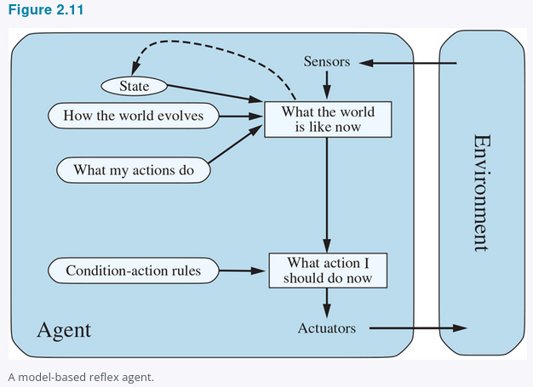
2.4.3 Model-Based Reflex Agents
2.4.3
Maintain internal state: a best guess about what the world is like now.
Transition model
How the world changes over time and how actions affect it.
Sensor model
How world states generate percepts.
Internal state
Tracks what is not evident in the current percept.
Figure 2.11
COMP 469 · Chapter 2
32
Notes:
SLIDE 33 · 2.4.3 Model-Based Reflex Agents
Suggested time: 6 minutes · Running total: 144 min · Chapter alignment: Section 2.4.3 and Figure 2.11
A model-based reflex agent maintains an internal state that represents its best estimate of what the world is like now. This internal state depends on the percept history, even though the program receives one current percept at a time.
Updating internal state requires two kinds of knowledge. The transition model describes how the world changes over time and how the agent's actions affect it. If a car turns the steering wheel, the model predicts how the vehicle's direction changes. If ghosts move after Pac-Man acts, the model predicts possible new ghost positions.
The sensor model describes how states of the world generate percepts. Brake lights in the world create illuminated regions in a camera image. A wet camera lens creates patterns that partially obscure the road. The agent uses the sensor model to interpret what a percept suggests about the underlying state.
The diagram combines the previous internal state, the last action, the transition model, the current percept, and the sensor model to produce an updated state estimate. Condition-action rules can then select an action from that estimated state.
This agent is still called reflex because the final action is selected by rules rather than explicit goal search or utility comparison. The important improvement is memory and state estimation. In a partially observable environment, the internal state may be uncertain or contain several possibilities. It is a best guess, not guaranteed ground truth.
TRANSITION
The pseudocode shows exactly where state, action history, and models enter the decision loop.
SOURCES
AIMA 4e, Section 2.4.3 and Figure 2.11.

Slide 34
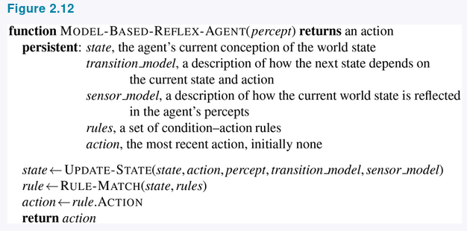
2.4.3 Model-Based Reflex Agent Pseudocode
2.4.3
The interesting step is UPDATE-STATE: combine old state, last action, current percept, transition model, and sensor model.
Partial observability means exact state may be impossible; the agent still must decide.
Figure 2.12
COMP 469 · Chapter 2
33
Notes:
SLIDE 34 · 2.4.3 Model-Based Reflex Agent Pseudocode
Suggested time: 6 minutes · Running total: 150 min · Chapter alignment: Section 2.4.3 and Figure 2.12
The model-based pseudocode adds persistent variables that the simple reflex agent did not have. These include state, the agent's current conception of the world; transition model, which explains how the world changes; sensor model, which explains how states produce percepts; rules, which connect estimated states to actions; and action, the previous action taken.
The key line is UPDATE-STATE. It combines the old state, the previous action, the new percept, the transition model, and the sensor model. The result is a new internal state description.
The program then uses RULE-MATCH on that updated state, selects the rule's action, stores the action for use during the next update, and returns it to the actuators. The previous action matters because state change depends partly on what the agent itself just did.
Notice what the program does not contain. It does not yet contain an explicit goal test or utility function. It estimates the current state and reacts according to rules. That is the difference between model-based reflex behavior and the goal-based and utility-based designs that follow.
In a real implementation, UPDATE-STATE may be simple or extremely sophisticated. It could update a few Boolean variables, track object positions, maintain probabilities over possible states, or process a learned world model. The pseudocode describes the functional role rather than requiring one specific technology.
TRANSITION
Internal state tells the agent where it believes it is; a goal tells the agent where it wants to go.
SOURCES
AIMA 4e, Section 2.4.3 and Figure 2.12.

Slide 35
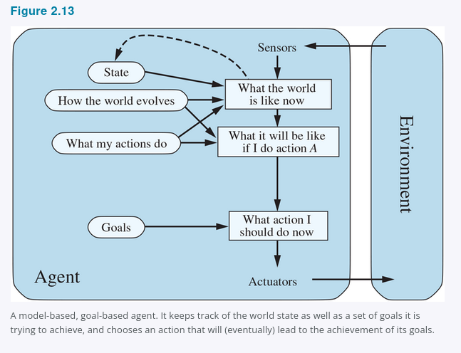
2.4.4 Goal-Based Agents
2.4.4
A current state is not enough; the agent also needs a goal.
Search / planning
Find action sequences that achieve goals. This transitions to Chapters 3-5.
Flexibility
Change the destination, and the same knowledge can support new behavior.
Cost
The agent may need to reason about many possible future action sequences.
Figure 2.13
COMP 469 · Chapter 2
34
Notes:
SLIDE 35 · 2.4.4 Goal-Based Agents
Suggested time: 6 minutes · Running total: 156 min · Chapter alignment: Section 2.4.4 and Figure 2.13
Knowing the current state is not always enough to choose an action. At an intersection, a taxi may be able to turn left, turn right, or continue straight. The correct choice depends on the destination. A goal-based agent therefore combines a state description with goal information.
The agent uses a model to predict what the world will be like after possible actions. It then asks whether those predicted states lead to the goal. When one action immediately achieves the goal, selection is simple. When the goal requires a long sequence of actions, the agent must consider alternative futures.
Search and planning are the AI subfields that find action sequences leading to goals. That is why this slide is the conceptual bridge from Chapter 2 to Chapters 3 through 5. Chapter 2 defines the goal-based architecture; the next chapters develop algorithms for searching through possible action sequences.
Goal-based decision making differs from a condition-action rule because it represents the reason for the action. A reflex agent brakes when brake lights appear because a rule fires. A goal-based agent brakes because the predicted consequence of not braking conflicts with the goal of avoiding a collision.
Goal-based agents are more flexible. Change the destination and the same model can support a new route. A reflex agent may require a new set of rules for each destination. The cost of flexibility is computation: predicting and comparing future action sequences can be expensive.
TRANSITION
The planning video makes the difference between reaction and look-ahead behavior visible.
SOURCES
AIMA 4e, Section 2.4.4 and Figure 2.13.

Slide 36
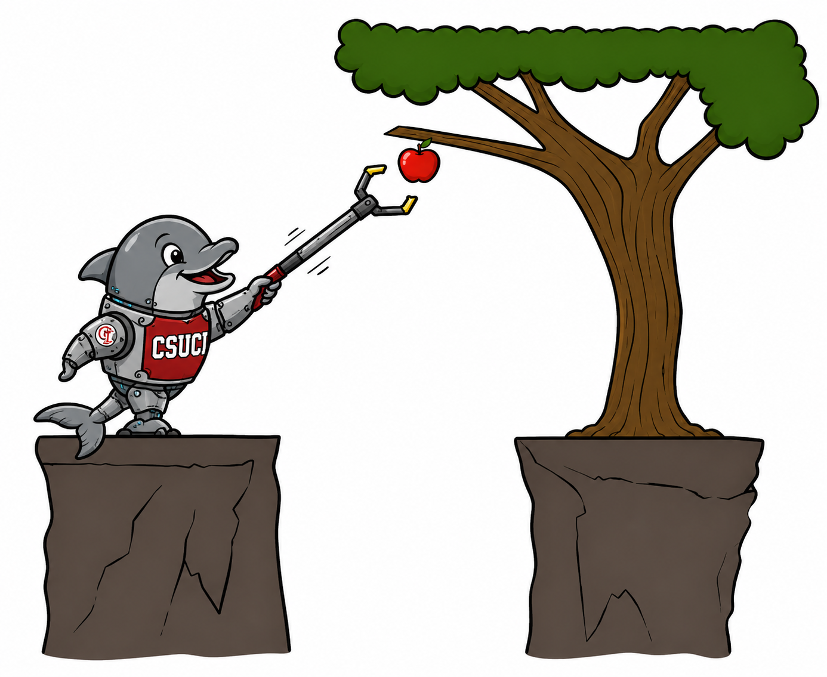
Planning Video Bridge: Reflex vs. Planning
Bridge
Reflex agent
Chooses an action from the current percept, or from internal state in the model-based case; does not consider future consequences.
Planning agent
Asks “what if?” and chooses actions based on predicted consequences. Must model how the world evolves and must formulate a goal test.
Replanning Pac-Man
Plans a little way ahead, acts, then replans from the new state. This is different from planning once and executing forever.
Key distinction: planning considers how the world WOULD BE, not just how it is now.
Planning distinctions
Optimal vs. complete planning compares best solution quality vs. guaranteed solution finding. Planning vs. replanning compares one long plan vs. repeated look-ahead as the state changes.
COMP 469 · Chapter 2
35
Notes:
SLIDE 36 · Planning Video Bridge: Reflex vs. Planning
Suggested time: 7 minutes · Running total: 163 min · Chapter alignment: Goal-based agents and transition to search
This slide is the bridge between Chapter 2 agent design and the next unit on search. The reflex agent chooses from the current percept, and possibly memory, but it does not explicitly evaluate future consequences. It asks, in effect, what rule applies now?
A planning agent asks a different question: what if I take this action, and then what happens after that? To answer that question, the agent needs a model of how the world evolves, a model of what its actions do, and a goal test for recognizing whether a predicted future is acceptable.
The Pac-Man examples make this distinction visible. A reflex Pac-Man may move toward an adjacent pellet because a rule fires. A planning Pac-Man can temporarily move away from a pellet if that helps it reach a better future state. Replanning means the agent looks ahead, acts, observes the new state, and plans again. That differs from computing one complete path and following it forever.
The slide also introduces two planning distinctions. Optimal planning concerns whether the agent finds the best solution according to cost or quality. Complete planning concerns whether the agent is guaranteed to find some solution if one exists. Planning versus replanning asks whether the agent commits to one long action sequence or repeatedly revises the plan as percepts change.
For this chapter, keep the boundary clear: Chapter 2 explains why a goal-based agent needs to consider future consequences. Chapter 3 explains the search algorithms that implement that look-ahead in detail.
TRANSITION
Goals tell the agent what counts as success, but they do not rank multiple successful outcomes. Utility provides that ranking.
SOURCES
Planning video transcript, approximately 1:19-10:05.
AIMA Chapter 2, Section 2.4.4.

Slide 37
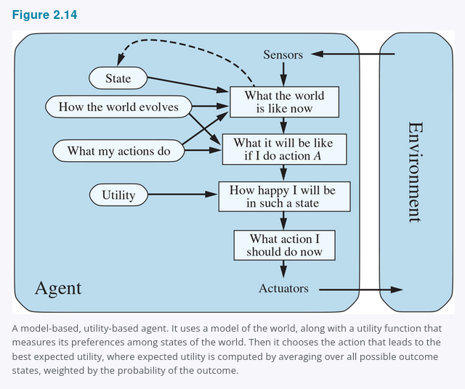
2.4.5 Utility-Based Agents
2.4.5
Goals say whether a state is acceptable; utility ranks how good it is.
Goal-based
Destination reached?
Yes or no.
Utility-based
How good is each outcome?
Fast, safe, comfortable, cheap?
Expected utility
Weigh utility by probability when outcomes are uncertain.
Utility handles conflicts and uncertainty.
Figure 2.14
COMP 469 · Chapter 2
36
Notes:
SLIDE 37 · 2.4.5 Utility-Based Agents
Suggested time: 6 minutes · Running total: 169 min · Chapter alignment: Section 2.4.5 and Figure 2.14
A goal usually gives a binary distinction: the destination is reached or it is not. In most environments, that is not enough to produce high-quality behavior. Many routes may reach the same destination, but they differ in safety, speed, cost, comfort, reliability, and energy use.
A utility function assigns a degree of desirability to outcomes. The agent predicts possible future states, evaluates how desirable those states are, and chooses an action that leads to the best expected result.
The chapter describes the utility function as an internalization of the performance measure. The performance measure is the external standard used to evaluate the agent. The utility function is the agent's internal representation of how desirable outcomes are. When the two agree, maximizing utility supports rational behavior according to the external standard.
Utility is especially useful in two situations. First, goals may conflict. A taxi may need to trade speed against safety or comfort against cost. Second, outcomes may be uncertain. No action may guarantee success, so the agent must weigh both the value and probability of each possible outcome.
A utility-based agent is not automatically simple. It still needs perception, state estimation, a model of possible outcomes, and an algorithm for comparing choices. The utility function makes the decision criterion explicit; it does not remove the computational difficulty.
TRANSITION
The next slide focuses on the two main reasons utility is more expressive than goals: tradeoffs and uncertainty.
SOURCES
AIMA 4e, Section 2.4.5 and Figure 2.14.

Slide 38
Utility Handles Tradeoffs and Uncertainty
2.4.5
Conflicting goals
Uncertain goals
Expected utility
Speed and safety can conflict. Utility specifies the tradeoff.
Several outcomes may be possible, none guaranteed.
Likelihood of success is weighed against outcome importance. Any rational agent behaves as if it maximizes expected utility, explicitly or not.
Utility function = internalization of the performance measure
If the internal utility function and external performance measure agree, maximizing utility supports rational behavior.
Caution: if the utility function is wrong, the agent may optimize the wrong objective.
COMP 469 · Chapter 2
37
Notes:
SLIDE 38 · Utility Handles Tradeoffs and Uncertainty
Suggested time: 5 minutes · Running total: 174 min · Chapter alignment: Section 2.4.5
Utility provides a common scale for comparing outcomes that satisfy different goals to different degrees. When speed and safety conflict, a utility function specifies how much one is worth relative to the other. When several outcomes are possible, expected utility combines each outcome's value with its probability.
Expected utility does not mean that the agent always receives the outcome with the highest utility. It means the agent chooses the action with the best probability-weighted average according to its model. A rational decision can still produce an unfortunate result because uncertainty remains.
In Pac-Man, an agent might compare an action that safely reaches one pellet with an action that could reach a power pellet and several ghosts but carries a greater risk of being caught. A utility function can assign values to score, survival, completion, and risk. The selected action depends on those values and the estimated probabilities.
The major caution is alignment. If the internal utility function does not match the external performance measure, the agent may optimize the wrong objective. Utility-based behavior is powerful because it is general; that same generality makes correct objective specification essential.
The chapter also notes that perfect rationality is usually computationally unattainable. Even when a utility function is correct, the agent may not have enough time or processing power to evaluate every possible action sequence. Practical agents approximate the best decision under resource limits.
TRANSITION
So far, every design assumes that the agent's rules, models, goals, or utility already exist. Learning explains how those components can improve.
SOURCES
AIMA 4e, Section 2.4.5.

Slide 39
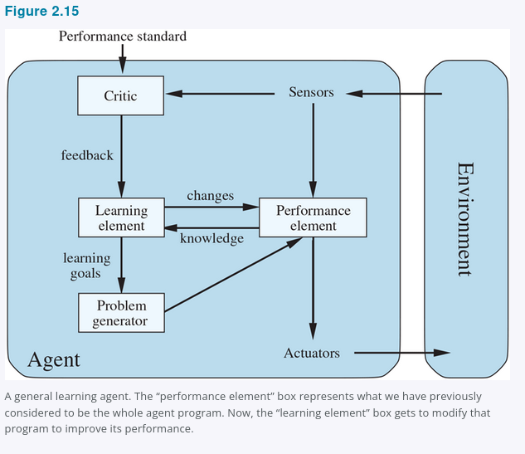
2.4.6 Learning Agents
2.4.6
Any agent type can be made into a learning agent.
Performance element
Selects external actions.
Learning element
Improves the performance element.
Critic
Evaluates behavior against a fixed performance standard.
Problem generator
Suggests exploratory actions for informative experience.
Figure 2.15
COMP 469 · Chapter 2
38
Notes:
SLIDE 39 · 2.4.6 Learning Agents
Suggested time: 7 minutes · Running total: 181 min · Chapter alignment: Section 2.4.6 and Figure 2.15
Any of the agent types we have discussed can be built as a learning agent. Learning is not a separate alternative that replaces reflex, model-based, goal-based, or utility-based design. It is a way for the components of those agents to improve through experience.
The chapter divides a learning agent into four conceptual components. The performance element selects external actions. It is the part we previously treated as the entire agent. The learning element modifies the performance element so that future behavior improves.
The critic evaluates how well the agent is doing relative to a fixed performance standard. Percepts alone do not automatically tell the agent whether an outcome is good. A chess program may perceive checkmate, but the critic and performance standard identify that result as success or failure.
The problem generator suggests exploratory actions that may produce informative experience. If the performance element always chooses the best-known action, the agent may never discover a better alternative. Exploration can reduce short-term performance while improving long-term knowledge.
Turing argued that programming every intelligent behavior by hand would be too slow and that learning machines should instead be taught. The same motivation applies here. Learning allows the agent to operate in unknown environments, correct inaccurate prior assumptions, and become more competent than its initial programming alone would allow.
TRANSITION
The next slide asks exactly which internal components a learning process can modify.
SOURCES
AIMA 4e, Section 2.4.6 and Figure 2.15.

Slide 40
Learning Agent Components: What Improves?
2.4.6
Performance element
Transition model
Sensor model
What action should I do now?
What do my actions do?
What percepts should I expect?
Utility / rules
Problem generator
What outcomes should I prefer?
What should I explore next?
Learning modifies agent components to better match feedback and improve performance.
COMP 469 · Chapter 2
39
Notes:
SLIDE 40 · Learning Agent Components: What Improves?
Suggested time: 6 minutes · Running total: 187 min · Chapter alignment: Section 2.4.6
The design of the learning element depends on the performance element. Before asking how an agent will learn, we should ask what mechanism will select actions after learning has occurred. Learning can then improve the components used by that mechanism.
The agent can learn a transition model by observing how states change after actions. An automated taxi can learn how braking pressure affects deceleration on wet pavement. The agent can improve a sensor model by learning how conditions such as glare, rain, or occlusion affect observations.
It can learn condition-action rules, a policy, a utility function, or parameters used by the performance element. Feedback from the critic identifies which changes improve performance. The performance standard should remain fixed conceptually; otherwise, the agent could improve its apparent score by changing the standard rather than improving its behavior.
The problem generator supports exploration. It identifies uncertain or poorly understood parts of the model and proposes actions that produce useful evidence. This is similar to an experiment: the immediate action may not be valuable for the task, but the information gained can improve future decisions.
The unifying idea is modification. Learning brings the agent's internal components into closer agreement with available feedback and with the actual environment. A system may learn one component while other components remain hand-designed.
TRANSITION
Learning and reasoning both depend on how the agent represents states, attributes, objects, and relationships.
SOURCES
AIMA 4e, Section 2.4.6.

Slide 41
2.4.6 Turing's Bet and the Fixed Standard
2.4.6
Turing's proposal (1950)
Turing considered programming intelligent machines by hand, estimated the work involved, and concluded that “some more expeditious method seems desirable.” His alternative: build machines that learn, then teach them.
The critic must be fixed
Galileo as problem generator
Feedback reshapes what it wants
Percepts do not announce success. A chess program can perceive that it has checkmated its opponent and still need a standard to know that this is good news. Think of the performance standard as sitting outside the agent — because the agent must not be able to edit it to fit its own behavior.
Dropping rocks from a tower in Pisa was not valuable in itself. Galileo was not trying to break the rocks. He was running an experiment to improve his own theory. The problem generator proposes actions that are suboptimal now and informative later.
Passengers shaken up on the trip leave no tip. Pedestrians cover their ears — and occasionally cut the wires — when the taxi sounds its horn continuously. Both are evidence the agent can use to revise its utility function.
Learning = pulling every component into closer agreement with the feedback
Improving a model so it matches reality is almost always worth doing on its own terms. Improving a reflex rule or a utility function is not — that needs information from the external standard. Hard-wired standards such as pain and hunger in animals play exactly this role.
COMP 469 · Chapter 2
40
Notes:
SLIDE 41 · 2.4.6 Turing's Bet and the Fixed Standard
Suggested time: 5 minutes · Running total: 192 min · Chapter alignment: Section 2.4.6
We have the four components of a learning agent. This slide is about why three of them are shaped the way they are.
Start with Turing, because it frames the whole enterprise. In his 1950 paper he seriously considered hand-programming an intelligent machine, estimated how much labour that would take, and concluded that some more expeditious method seemed desirable. His proposal was to build machines that learn and then teach them. That is now the preferred route to state-of-the-art systems across most of AI, and it is worth telling students that the idea is more than seventy-five years old.
Now the critic, and this is the conceptually important one. The critic tells the learning element how well the agent is doing against a performance standard, and the standard has to be fixed. Why? Because percepts by themselves carry no verdict. A chess program can receive a percept indicating that it has checkmated its opponent; nothing in that percept says checkmating is good. The standard supplies that. And it must sit conceptually outside the agent, because an agent that could modify its own standard could always succeed by lowering the bar. When students later meet reward hacking, this is the slide to point back to.
The problem generator gets Galileo. Dropping rocks from the tower at Pisa had no value in itself — he was not trying to break the rocks, and he was certainly not trying to modify the brains of any pedestrians below. He was trying to modify his own brain by getting a better theory of motion. That is exactly the problem generator's job: propose actions that look suboptimal by current knowledge because they will produce informative experience. If the performance element always got its way, the agent would keep doing whatever is currently best and never discover anything better.
The third card is about where information for learning comes from. The taxi that shakes its passengers up receives no tips, and the external standard has to tell it that lost tips are a negative contribution, at which point it can learn that violent manoeuvres do not serve it. The taxi that sounds its horn continuously to warn pedestrians observes people covering their ears, using bad language, and occasionally cutting the wires to the horn — human behaviour that is evidence about human preferences. In this sense the performance standard singles out part of the incoming percept as reward or penalty. Pain and hunger in animals are hard-wired versions of the same mechanism.
One asymmetry to close on, on the bottom line: improving the model components so they match reality is almost always a good idea regardless of the external standard. Improving a reflex rule or a utility function is not — that specifically requires information from the standard, because there is no other way to know which behaviour was better.
TRANSITION
That covers how components improve. The last question is how they represent the world in the first place.
SOURCES
AIMA 4e, Section 2.4.6; Turing (1950).

Slide 42
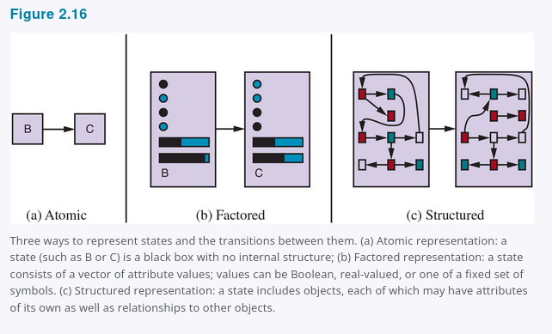
2.4.7 Representing the World Inside the Agent
2.4.7
Atomic
Factored
Structured
State is a black box.
Example: city name only.
Used in search, games, HMMs, MDPs.
State is a set of variables.
Example: location, fuel, speed, weather.
Used in CSPs, logic, Bayes nets, planning.
Objects plus relations.
Example: truck blocking cow near driveway.
Used in first-order logic, databases, language.
less expressive, easier reasoning
more expressive, harder reasoning
Design choice: enough expressive power for the task, but not more than the agent can reason with efficiently.
Figure 2.16
COMP 469 · Chapter 2
41
Notes:
SLIDE 42 · 2.4.7 Representing the World Inside the Agent
Suggested time: 7 minutes · Running total: 199 min · Chapter alignment: Section 2.4.7 and Figure 2.16
Chapter 2 closes by comparing three levels of representation: atomic, factored, and structured. These are not agent types. They describe how agent components represent states and relationships in the environment.
In an atomic representation, each state is an indivisible label. A route-planning state might be represented only by the current city. The system can distinguish Arad from Bucharest, but the state itself has no internal attributes. Search, game-playing, hidden Markov models, and Markov decision processes often use atomic states.
In a factored representation, a state is a collection of variables and values. A driving state might include location, fuel level, speed, weather, warning lights, and available money for tolls. Two states can share some attributes while differing in others. Constraint satisfaction, propositional logic, planning, Bayesian networks, and many machine-learning methods use factored representations.
In a structured representation, the system represents objects and relationships explicitly. Instead of one giant variable describing a truck, cow, road, and driveway situation, the representation contains separate objects and relations among them. First-order logic, relational databases, and much of natural-language understanding rely on structured representations.
More expressive representations can describe complex situations more naturally and concisely, but reasoning and learning usually become more difficult. The design goal is not maximum expressiveness; it is enough expressive power for the task while remaining computationally manageable. The chapter also notes that concepts can be stored locally or distributed across many memory locations, an idea that becomes important later in neural representations.
TRANSITION
We can now compare all of the agent program designs in one view.
SOURCES
AIMA 4e, Section 2.4.7 and Figure 2.16.

Slide 43
2.4.7 Expressiveness Has a Price
2.4.7
How many pages does it take to write down the rules of chess?
Atomic
Factored
Structured
≈ 10³⁸
thousands
1–2
pages, written in a language of finite-state automata
of pages, written in propositional logic
pages, written in first-order logic
The same content, expressed more concisely — and reasoned over more slowly
Choosing a point on the axis
A more expressive representation captures everything a less expressive one can, at least as concisely, plus more — but reasoning and learning get harder as expressive power rises. Intelligent systems for the real world may need to operate at every point on the axis at once.
Rule of thumb: take the least expressive representation that still captures what the task requires.
COMP 469 · Chapter 2
42
Notes:
SLIDE 43 · 2.4.7 Expressiveness Has a Price
Suggested time: 3 minutes · Running total: 202 min · Chapter alignment: Section 2.4.7
The previous slide gave you atomic, factored, and structured as an axis of increasing expressiveness. This slide puts a number on what that axis costs, using one worked example: how long does it take to write down the rules of chess?
In a structured representation — first-order logic, where you can talk about objects like pieces and squares and relations like attacks and occupies — it takes a page or two. In a factored representation like propositional logic, where a state is a fixed set of variables with values, it takes thousands of pages, because you have to spell out every combination that first-order logic captured with quantified variables. And in an atomic representation, where each state is an indivisible black box and the only question you can ask about two states is whether they are the same or different, it takes on the order of ten to the thirty-eighth pages.
That is the sense in which expressiveness is a real engineering property and not a matter of taste. A more expressive language can capture, at least as concisely, everything a less expressive one captures, plus more — and often far more concisely.
The catch is on the other side. Reasoning and learning become more complex as expressive power increases. First-order inference is harder than propositional inference, which is harder than search over atomic states. So the design question is not which representation is most powerful. It is which is the least expressive representation that still captures what the task actually requires. And the chapter's closing observation is that real-world systems may need to operate at several points on the axis simultaneously — atomic search inside a factored planner inside a structured knowledge base.
TRANSITION
There is a second, independent representation axis that the chapter mentions only briefly and that turns out to matter enormously.
SOURCES
AIMA 4e, Section 2.4.7.

Slide 44
2.4.7 Localist and Distributed Representations
2.4.7
A second axis: how do concepts map onto locations in memory — or in a brain?
Localist
Distributed
One concept, one memory location, and the mapping between them is arbitrary. Garble a few bits in transmission and Truck can become the entirely unrelated concept Truce.
Each concept is spread across many locations, and each location contributes to many concepts. A concept becomes a point in a multidimensional space.
Truck
Truce
one concept, spread across every cell
Two cells apart in memory, two meanings with nothing in common.
Garble a few bits and you move to a nearby point, which carries a similar meaning.
Distributed representations are more robust to noise and information loss
This axis is independent of atomic, factored, and structured — it asks where the information physically lives rather than how much it can express. It is also the bridge from Chapter 2 to the learned vector representations behind modern neural systems (Chapter 21).
COMP 469 · Chapter 2
43
Notes:
SLIDE 44 · 2.4.7 Localist and Distributed Representations
Suggested time: 3 minutes · Running total: 205 min · Chapter alignment: Section 2.4.7
The chapter closes with a second representation axis, and it gets only a paragraph in the text, which undersells how much it matters for anyone who will go on to work with neural systems. It is a separate question from atomic versus factored versus structured. That first axis asked how much a representation can express. This one asks where the information physically sits, whether in a computer's memory or in a brain.
A localist representation has a one-to-one mapping between concepts and memory locations. Concept, cell. Concept, cell. The mapping is arbitrary — nothing about the location tells you anything about the meaning. The consequence is the example on the left. If a transmission error garbles a few bits, the address you land on has no relationship to the address you left, so Truck can turn into Truce, a completely unrelated concept. Nearness in memory carries no information about nearness in meaning.
A distributed representation spreads each concept over many locations, and each location participates in representing many different concepts. The useful way to think about it is geometric: each concept is a point in a multidimensional space. Now garble a few bits and you move a short distance in that space — you land on a nearby point, which has a similar meaning. The representation degrades gracefully instead of catastrophically.
That robustness against noise and information loss is the headline property. It is also, and I want students to see this connection explicitly, exactly the property that makes learned vector representations work in modern systems. When you encounter embeddings — where similar items sit close together and arithmetic on the vectors is meaningful — you are looking at a distributed representation, and this paragraph in Chapter 2 is where the idea enters the book.
TRANSITION
That completes the chapter's technical content. Before the summary, it is worth seeing where these ideas came from.
SOURCES
AIMA 4e, Section 2.4.7.

Slide 45
All Agent Program Designs in Chapter 2
Synthesis
Table-driven
Simple reflex
Model-based reflex
Stores percept history and looks up an action in a table.
Maps current percept to action using condition-action rules.
Maintains internal state using transition and sensor models.
Goal-based
Utility-based
Learning
Chooses actions by reasoning toward goals.
Ranks outcomes and maximizes expected utility.
Improves components from feedback and experience.
These are design patterns, not rigid boxes. Real systems combine them, and not every utility-based agent needs a model of the world.
COMP 469 · Chapter 2
44
Notes:
SLIDE 45 · All Agent Program Designs in Chapter 2
Suggested time: 5 minutes · Running total: 210 min · Chapter alignment: Synthesis of Sections 2.4.1-2.4.6
This slide is a checkpoint covering every agent design presented in the lecture. The table-driven agent stores the percept history and looks up an action. It represents the complete agent function explicitly but does not scale.
The simple reflex agent maps the current percept-derived state directly to an action using condition-action rules. It is compact and fast but depends on sufficient observability.
The model-based reflex agent maintains internal state using a transition model and sensor model, then applies rules to the estimated current state. It is designed for partial observability.
The goal-based agent adds a goal and predicts future states to find an action sequence that reaches that goal. Search and planning provide the mechanisms for this look-ahead behavior.
The utility-based agent ranks outcomes and chooses the action with the highest expected utility. It supports tradeoffs and uncertainty when a binary goal is not enough.
The learning agent improves components through feedback and exploration. Learning can be added to any of the other designs. A model-based utility agent can learn its transition model; a reflex agent can learn rules; a goal-based agent can learn better search guidance.
These are design patterns, not rigid boxes. Real systems commonly combine them. The most useful classification is the one that explains what information the system represents and how it selects actions.
TRANSITION
The environment properties tell us which of these design capabilities are necessary.
SOURCES
AIMA 4e, Sections 2.4.1-2.4.6.

Slide 46
Choosing an Agent Design from Environment Properties
Synthesis
Fully observable + short horizon
Partially observable
Simple reflex
Fast condition-action rules may be enough.
Model-based reflex
Maintain internal state and update it using models.
Long-term objective
Tradeoffs / uncertainty
Goal-based
Search or planning over future action sequences.
Utility-based
Compare outcomes by expected utility.
Unknown rules / changing world
Learning agent
Improve model, utility, rules, or policy from feedback.
COMP 469 · Chapter 2
45
Notes:
SLIDE 46 · Choosing an Agent Design from Environment Properties
Suggested time: 6 minutes · Running total: 216 min · Chapter alignment: Synthesis of Sections 2.3 and 2.4
The practical design rule is to let the task environment drive the agent architecture. In a fully observable, simple environment, a simple reflex agent may be sufficient. There is no benefit in building a complex planner when a reliable current-state rule produces the correct action.
Partial observability creates a need for memory and state estimation, which points toward a model-based agent. A long-term objective that requires a sequence of actions creates a need for goals, prediction, search, or planning.
When several successful outcomes differ in quality, or when outcomes are uncertain, utility provides a way to compare them. When the rules, models, environment, or performance measure are unknown or changing, learning becomes necessary.
These choices are cumulative rather than exclusive. A self-driving system may be model-based because it tracks hidden state, goal-based because it navigates to a destination, utility-based because it balances safety and travel time, and learning-based because it improves perception and prediction from data. It may also contain simple reflex safety rules for immediate braking.
A disciplined design process therefore follows four steps. First, define the agent and environment. Second, specify PEAS. Third, classify the environment. Fourth, select the least complex agent design that can represent the required information and make adequate decisions.
TRANSITION
The PEAS activity lets students apply this workflow before proposing an algorithm.
SOURCES
AIMA 4e, Sections 2.3 and 2.4.

Slide 47
Class Activity: Build a PEAS Description
Activity
Choose one system, then fill in PEAS before proposing an algorithm.
Autonomous Pac-Man
Campus chatbot
Email phishing triage agent
Robotic delivery cart
Performance
Environment
Write 2-3 concrete items.
Write 2-3 concrete items.
Actuators
Sensors
Write 2-3 concrete items.
Write 2-3 concrete items.
Checkpoint: if you cannot fill in PEAS, you are not ready to choose an algorithm.
COMP 469 · Chapter 2
46
Notes:
SLIDE 47 · Class Activity: Build a PEAS Description
Suggested time: 12 minutes · Running total: 228 min · Chapter alignment: Applied Section 2.3.1
We are going to pause the lecture and specify a task before discussing an implementation. Each group will choose one system: autonomous Pac-Man, a campus chatbot, an email phishing triage agent, or a robotic delivery cart.
Your group must write at least two concrete items for each PEAS category. For Performance, avoid vague words such as 'good' or 'smart.' State what successful behavior means and identify at least one failure or cost. For Environment, identify the entities and conditions the agent must handle. For Actuators, list the outputs or actions that can change the environment. For Sensors, list the information the agent can actually receive.
After PEAS, classify the environment on at least three dimensions and recommend an agent design. Be prepared to explain why the design matches the environment. You have approximately eight minutes, followed by short reports.
As you work, remember that an algorithm cannot compensate for missing task specification. If the performance measure is unclear, there is no objective definition of rational behavior. If the sensors cannot provide relevant information, the agent may need memory, a model, exploration, or a redesigned architecture.
When groups report, listen for mismatches. A chatbot that can only display text cannot directly reset an account unless an actuator or integration provides that capability. A phishing triage system cannot inspect attachment behavior if the sensors provide only the subject line. A delivery cart expected to operate in rain needs sensors and environmental assumptions that support that requirement.
TRANSITION
We will now apply the same vocabulary to the autonomous Pac-Man program used in the class demonstration.
SOURCES
AIMA 4e, Section 2.3.1; lecture deck activity.

Slide 48
Class Demo: Autonomous Pac-Man Agent
Demo
Use the game to make the Chapter 2 vocabulary concrete.
What are the percepts?
What actions can the agent return?
What is the performance measure?
Does it use memory or only current state?
Is it reflex, model-based, goal-based, utility-based, or mixed?
Next: search algorithms are one way to make goal-based agents act rationally.
COMP 469 · Chapter 2
47
Notes:
SLIDE 48 · Class Demo: Autonomous Pac-Man Agent
Suggested time: 10 minutes · Running total: 238 min · Chapter alignment: Applied Sections 2.1-2.4.6
As the game runs, do not evaluate it only by whether Pac-Man wins. Identify the agent design. The environment is the maze with walls, pellets, power pellets, ghosts, and scoring rules. The percept supplied to the program includes position, legal moves, remaining pellets, power-pellet state, and ghost information.
The actuators are the movement actions returned by the program. Each action changes the state and produces a new percept. The performance measure includes score, survival, and completion. If the program chooses the action with the highest calculated value, it has a utility-based component. If it searches paths to pellets, it has a goal-based component. If it tracks timers or ghost release state, it has a model-based component.
Watch for the power pellet. A normal pellet changes the score only. A power pellet changes the environment by placing ghosts into a frightened state for a limited time. If the agent tracks the remaining duration, that information becomes internal state. During frightened mode, the utility of approaching a ghost changes from strongly negative to positive.
Ask whether the agent is rational. The answer depends on the performance measure and the information available. A locally reasonable move can still lead to a poor later outcome if the agent has a short planning horizon. A system can therefore be rational relative to a limited model while remaining less capable than a more complete planner.
This demonstration illustrates why the textbook categories can overlap in real code. The program does not need to fit one pure box. The categories help us identify which information is explicit and which decision mechanism is being used.
After this vocabulary mapping, the next slide identifies the live code files. The point of the live demo is not to teach Pygame. The point is to show that the visual environment can remain fixed while the agent program changes. That separation reinforces the Chapter 2 formula: agent equals architecture plus program.
TRANSITION
Next, we will connect the live Pac-Man behavior to the specific Python agent files that implement the Chapter 2 agent designs.
SOURCES
AIMA 4e, Sections 2.1-2.4.6; autonomous Pac-Man classroom code.

Slide 49
Live Code Demo: Five Chapter 2 Agent Programs
Demo code
The graphics and environment stay fixed; only the agent program changes.
Shared environment / architecture: pacman_chapter2_engine.py — sensors, actuators, maze, ghosts, scoring, graphics, and performance feedback
Simple Reflex 01_simple_reflex_agent_ch2.py
Model-Based Reflex 02_model_based_reflex_agent_ch2.py
current percept + ordered if-then rules
internal state + transition_model + sensor_model
Goal-Based 03_goal_based_agent_ch2.py
Utility-Based 04_utility_based_agent_ch2.py
formulate_goal + make_plan + execute first action
expected_utility over each legal action
Learning 05_learning_agent_ch2.py
performance element + critic + learning + problem generator
Run order: 1 → 2 → 3 → 4 → 5. After each one, ask what changed in the decision process.
Code focus: the section marked CHAPTER 2 AGENT PROGRAM STARTS HERE.
COMP 469 · Chapter 2
48
Notes:
SLIDE 49 · Live Code Demo: Five Chapter 2 Agent Programs
Suggested time: 10 minutes · Running total: 248 min · Chapter alignment: Live demonstration files; Section 2.4 agent program
This slide identifies the code we will use for the live demonstration. The shared file, pacman_chapter2_engine.py, represents the environment and architecture. It handles the maze, graphics, sensors, actuators, ghosts, scoring, and performance feedback. We are not studying that file first because it is support code for the classroom display.
The important instructional point is that the environment remains fixed while the agent program changes. Each numbered file contains one Chapter 2 agent program. Project the section marked CHAPTER 2 AGENT PROGRAM STARTS HERE, then run the file so students can connect the code to the visible behavior.
Start with 01_simple_reflex_agent_ch2.py. Point out that the decision method receives only the current percept and applies ordered condition-action rules. It has no memory, model, goal, utility function, or learning component.
Then use 02_model_based_reflex_agent_ch2.py. Show the InternalState structure and the transition_model, sensor_model, update_state, and choose_action methods. This agent still fires reflex rules, but those rules operate on an updated internal state instead of the current percept alone.
Next use 03_goal_based_agent_ch2.py. Show formulate_goal, make_plan, and choose_action. The agent selects a desired future state, creates an action sequence, and executes the first step. Treat the path-planning helper as a black box for now; the search algorithm itself belongs to Chapter 3.
Then use 04_utility_based_agent_ch2.py. Show expected_utility and choose_action. This agent does not commit to a single stored plan. It evaluates legal actions by expected desirability, including food reward, movement cost, and ghost risk, then chooses the action with maximum expected utility.
Finally use 05_learning_agent_ch2.py. Show the four Chapter 2 learning-agent components: performance_element, learning_element, critic, and problem_generator. The performance element chooses actions; the critic supplies feedback; the learning element modifies future preferences; and the problem generator encourages exploration.
The teaching sequence is one through five. After each run, ask the same question: what information did this agent use that the previous one did not? That comparison keeps the demonstration anchored in Chapter 2 rather than turning it into a programming exercise.
TRANSITION
After the code demonstration, we will return to the planning video boundary and separate Chapter 2 concepts from Chapter 3 algorithms.
SOURCES
Uploaded files: pacman_chapter2_engine.py and 01-05 *_agent_ch2.py.
AIMA Chapter 2, Sections 2.4.1-2.4.6.

Slide 50
How the Planning Video Fits This Chapter
Video
Watch now for Chapter 2
Comes back in Chapter 3
1:19-10:05: agents that plan, reflex agents, Pac-Man examples, planning versus replanning.
After ~11:48: search problem formulation, state spaces, search trees, DFS, BFS, UCS.
Chapter boundary
Chapter 2 explains what a goal-based agent is. Chapter 3 explains how search implements it.
We watch the first segment as a bridge, then stop before the full search algorithms.
COMP 469 · Chapter 2
49
Notes:
SLIDE 50 · How the Planning Video Fits This Chapter
Suggested time: 2 minutes · Running total: 250 min · Chapter alignment: Chapter boundary and course sequencing
This slide establishes the boundary between the current chapter and the next unit. The first portion of the planning video belongs here because it compares reflex agents with agents that predict future consequences. The Pac-Man demonstrations show why local condition-action rules can fail and why a goal-based agent may need to plan or replan.
After approximately eleven minutes, the lecture begins formal search problem formulation: state spaces, start states, successor functions, goal tests, search trees, depth-first search, breadth-first search, and uniform-cost search. Those topics belong to Chapter 3.
The conceptual sequence is simple. Chapter 2 explains what a goal-based agent needs: a state, a model of action consequences, and a goal. Chapter 3 explains how search can compute an action sequence that reaches that goal. Keeping the boundary clear prevents the agent architecture and the search algorithm from being treated as the same concept.
TRANSITION
We will close by compressing the chapter into a small set of design rules.
SOURCES
Planning video transcript, approximately 1:19 onward.
AIMA 4e, Section 2.4.4.

Slide 51
Where These Ideas Came From
History
Aristotle
Turing
McCarthy
Samuel
Nicomachean Ethics
1950
1958
1959, 1967
Practical reasoning — action at the center of intelligence.
Hand-programming is too slow; build machines that learn and teach them.
“Programs with Common Sense” — the logical, goal-directed line of AI.
A checkers program that improves with play: the learning-agent design, working.
Fikes & Nilsson
Doyle
Pearl
Control theory
1971
1983
1988
throughout
Shakey — the first robot embodiment of a logical, goal-based agent.
Predicted that rational agent design would become the core mission of AI.
Probability and utility in depth; the shift toward utility-based agents.
A controller is an agent; its subfields map onto our environment dimensions.
AI spent decades on isolated components; the whole-agent view is now the default
Question-answering systems, theorem provers, and vision systems were studied largely in isolation. Genesereth and Nilsson (1987) were an influential exception, and the agent-based approach now runs through software engineering, operating systems, and the AAMAS conference series.
COMP 469 · Chapter 2
50
Notes:
SLIDE 51 · Where These Ideas Came From
Suggested time: 3 minutes · Running total: 253 min · Chapter alignment: Bibliographical and Historical Notes
Before the summary, a short slide on lineage. Upper-division students benefit from knowing that these ideas have addresses, and it makes the reading list navigable.
The idea that action sits at the centre of intelligence — practical reasoning — goes back at least to Aristotle's Nicomachean Ethics, and it resurfaces in McCarthy's 1958 paper Programs with Common Sense, which is where the logical, goal-directed strand of AI really starts. Turing's 1950 paper is the origin of the learning-agent argument we saw two slides ago. Arthur Samuel's checkers program, in 1959 and again in 1967, is the earliest well-known program that actually embodies the learning-agent design rather than merely describing it. Shakey, from Fikes and Nilsson in 1971, is the first robot to embody a logical, goal-based agent.
Two entries mark turning points in how the field saw itself. Jon Doyle in 1983 predicted that rational agent design would come to be regarded as AI's core mission while other popular topics spun off into separate disciplines — a prediction that reads as fairly accurate. And Judea Pearl's 1988 text was the first in AI to treat probability and utility theory in depth; the chapter credits it as probably the single biggest factor in the rapid shift toward utility-based agents in the 1990s.
The last card is the one students find most surprising. Control theory has been designing agents all along under a different vocabulary — the concept of a controller is identical to that of an agent. Classical control handles fully observable, deterministic environments; stochastic optimal control handles partially observable, stochastic ones; hybrid control handles environments with both discrete and continuous elements. Our environment dimensions are not arbitrary; they carve the space the same way a neighbouring discipline already did.
The bottom line is worth saying out loud. For most of its history AI concentrated on isolated components — question answerers, theorem provers, vision systems — rather than whole agents. Genesereth and Nilsson in 1987 were an influential exception. The whole-agent view that organizes this entire course is comparatively recent, and it now runs through software engineering, operating systems, and a dedicated conference series in AAMAS.
TRANSITION
That is the chapter. Let us collect the points you should be able to use.
SOURCES
AIMA 4e, Chapter 2, Bibliographical and Historical Notes.

Slide 52
Chapter 2 Takeaways
Summary
An agent perceives an environment through sensors and acts through actuators.
A rational agent maximizes expected performance, not hindsight perfection.
PEAS specifies the task: performance, environment, actuators, sensors.
Environment properties determine which agent design is appropriate.
Agent programs include table-driven, simple reflex, model-based, goal-based, utility-based, and learning agents.
Representations determine what the agent can express and how hard reasoning becomes.
Define the agent -> Specify the task -> Classify the environment -> Choose the design
COMP 469 · Chapter 2
51
Notes:
SLIDE 52 · Chapter 2 Takeaways
Suggested time: 4 minutes · Running total: 257 min · Chapter alignment: Chapter summary
Chapter 2 presents AI as the science and engineering of agent design. An agent perceives an environment through sensors and acts through actuators. The agent function maps percept sequences to actions, while the agent program implements that mapping on an architecture.
A rational agent chooses the action expected to maximize its performance measure, given its prior knowledge, available actions, and percept sequence. Rationality is not omniscience or hindsight perfection. Information gathering, learning, and autonomy can all be rational because they improve later decisions.
PEAS specifies the task through Performance measure, Environment, Actuators, and Sensors. Environment dimensions—observability, number of agents, determinism, episodic or sequential structure, static or dynamic behavior, discrete or continuous state, and known or unknown rules—guide the design.
The table-driven agent is a conceptual baseline but does not scale. Simple reflex agents use current-percept rules. Model-based reflex agents maintain internal state. Goal-based agents predict futures that achieve goals. Utility-based agents compare outcomes and uncertainty. Learning agents improve components through feedback and exploration.
Finally, internal representations can be atomic, factored, or structured. More expressive representations describe richer worlds but usually require more complex reasoning.
The complete workflow is: define the agent, specify the task, classify the environment, and choose the design. The next unit begins with goal-based agents and develops search algorithms for finding action sequences.
SOURCES
AIMA 4e, Chapter 2 summary.

